Slide 1
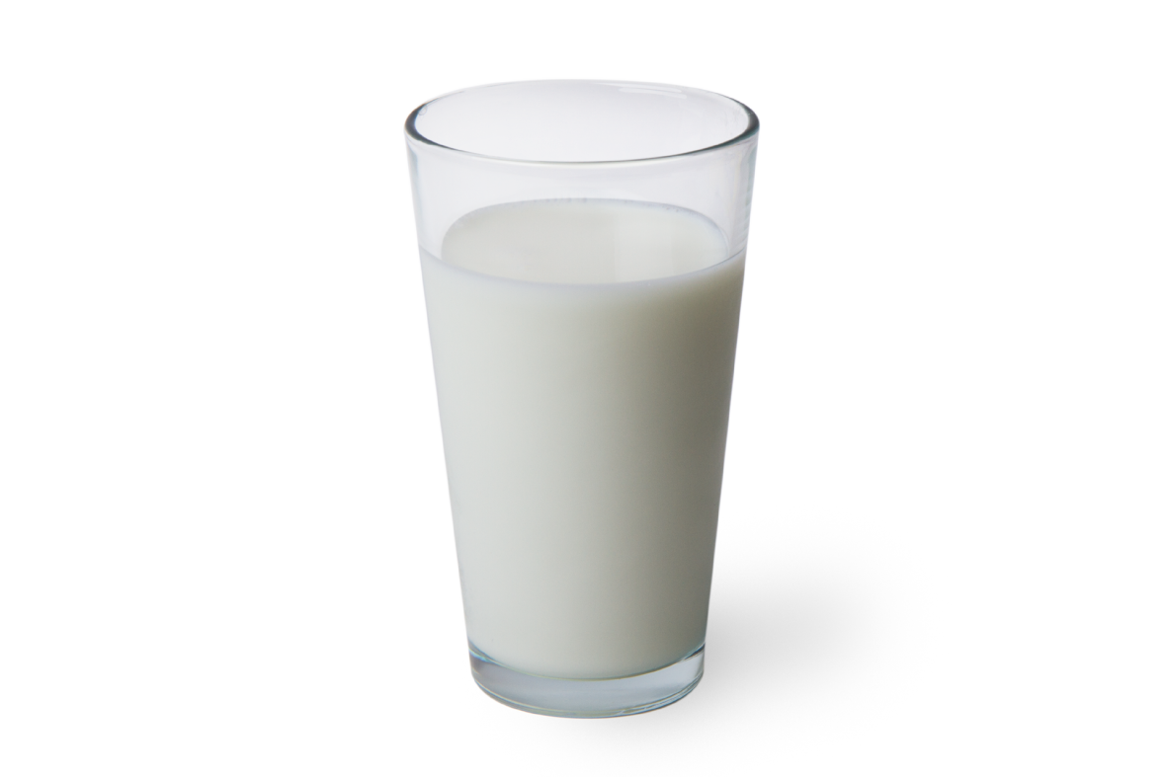
“The Raw Truth”
Weighing the Risk/Benefits of
Un-Pasteurized Raw Milk

Slide 2
The Raw Battle Continues….
Is raw milk healthier than pasteurized?
“Big Dairy” conspiracy or health concern?
High temp/short time or batch
pasteurization healthier?

Slide 3
“THE CLAIMED BENEFITS”:
Nutritional
Allergy
Lactose Intolerance
Beneficial Microflora

Slide 4
“THE CLAIMED RISKS”:
Human Pathogens
Hospitalization
Death

Slide 5
Battle Lines Drawn…
3.4% of US drink raw milk…
11 Million
Americans
U.S. per state raw milk regulations

Slide 6
Raw Milk in Lafayette Indiana?
$10.99
A Gallon
State of Indiana does allow raw milk sales at retail stores if labeled:
“NOT FOR HUMAN CONSUMPTION“

Slide 7
Objectives:
1. Accurate Risk Assessment of Drinking Raw Milk
2. True Differences in Vitamin/Minerals
3. Healing Allergies Claim
4. Cure for Lactose Intolerance
5. More Beneficial Microflora in Raw Milk

Slide 8
References/Data:
Lucey, John A. PhD. Raw Milk Consumption: Risks and Benefits. Nutrition Today 50(4):p 189-193, July/August 2015. | DOI: 10.1097/NT.0000000000000108
Griffiths MW. The microbiological safety of raw milk. In: Griffiths MW, ed. Improving the Safety and Quality of Milk, Volume 1: Milk Production and Processing. Boca Raton, FL: CRC Press; 2010: 27–63.
Soboleva T. Assessment of the microbiological risks associated with the consumption of raw milk. MPI Technical Paper No. 2014/12. Accessed November 25, 2014.
8. Oliver SP, Jayarao BM, Almeida RA. Foodborne pathogens in milk and the dairy farm environment: food safety and public health implications. Foodborne Pathog Dis. 2005; 2: 115–129.
MacDonald LE, Brett J, Kelton D, et al. A systematic review and meta-analysis of the effects of pasteurization on milk vitamins, and evidence for raw milk consumption and other health-related outcomes. J Food Prot. 2001; 74: 1814–1832.
Barrows R. Report of the raw milk policy working group. Department of Agriculture, Trade, and Consumer Protection. Accessed November 25, 2014.
Wijga AH, Smit HA, Kerkhof M, et al. Association of consumption of products containing milk fat with reduced asthma risk in pre-school children: the PIAMA birth cohort study. Thorax. 2003; 58: 567–572.
Van Neerven RJJ, Knol EF, Heck JML, et al. Which factors in raw cow’s milk contribute to protection against allergies? J Allergy Clin Immunol. 2012; 130: 853–858.
Beerens H, de la Perriere HB, Gravini F. Evaluation of the hygienic quality of raw milk based on the presence of bifidobacteria: the cow as a source of faecal contamination. Int J Food Microbiol. 2000; 54: 163–169.
Mummah S, Oelrich B, Hope J, Vu Q, Gardner CD. Effect of raw milk on lactose intolerance: a randomized controlled pilot study. Ann Fam Med. 2014 Mar-Apr;12(2):134-41. doi: 10.1370/afm.1618. PMID: 24615309; PMCID: PMC3948760.
Hill C, Guarner F, Reid G, et al. The International Scientific Association for Probiotics and Prebiotics consensus statement on the scope and appropriate use of the term probiotic. Nat Rev Gastroenterol Hepatol. 2014; 11: 506–514.
Beerens H, de la Perriere HB, Gravini F. Evaluation of the hygienic quality of raw milk based on the presence of bifidobacteria: the cow as a source of faecal contamination. Int J Food Microbiol. 2000; 54: 163–169.

Slide 9
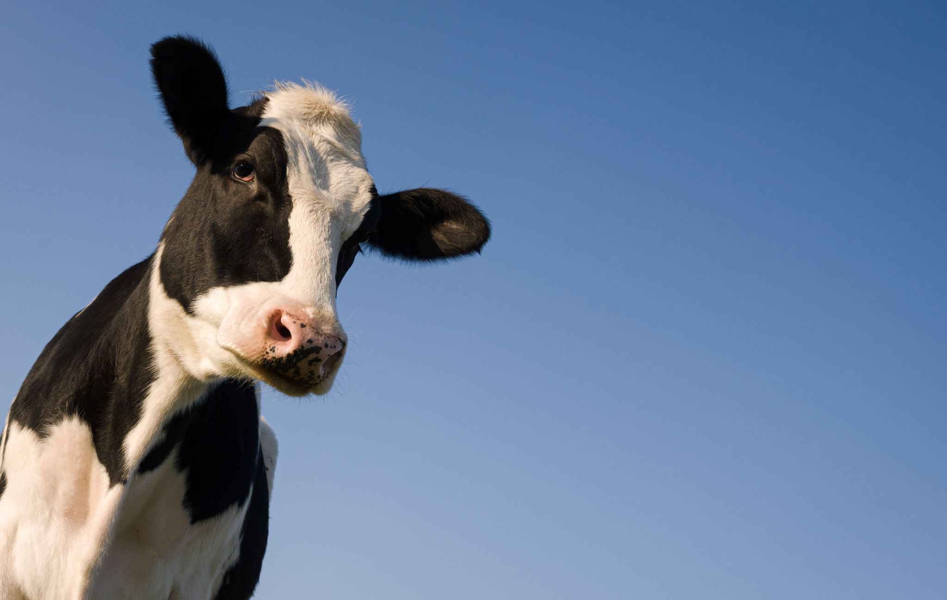
How risky is drinking raw milk ?
“It’s not worth the risk?”
Raw Milk related Illnesses…

Slide 10
Does this scare you?
Raw Dairy related Illnesses…
U.S. ANNUAL REPORT
781 ILLNESSES
22 HOSPITALIZATIONS
* NOTE: This is for raw diary that included milks, butters, cheeses.

Slide 11
U.S. Raw Dairy related Illnesses…
DEATHS
2
2013-2018

Slide 12
How about raw milk by itself?
Raw Milk related Illnesses…
U.S. ANNUAL REPORT
112 ILLNESSES
5 HOSPITALIZATIONS
NOTE: This includes cows, goats, and sheep raw milk

Slide 13
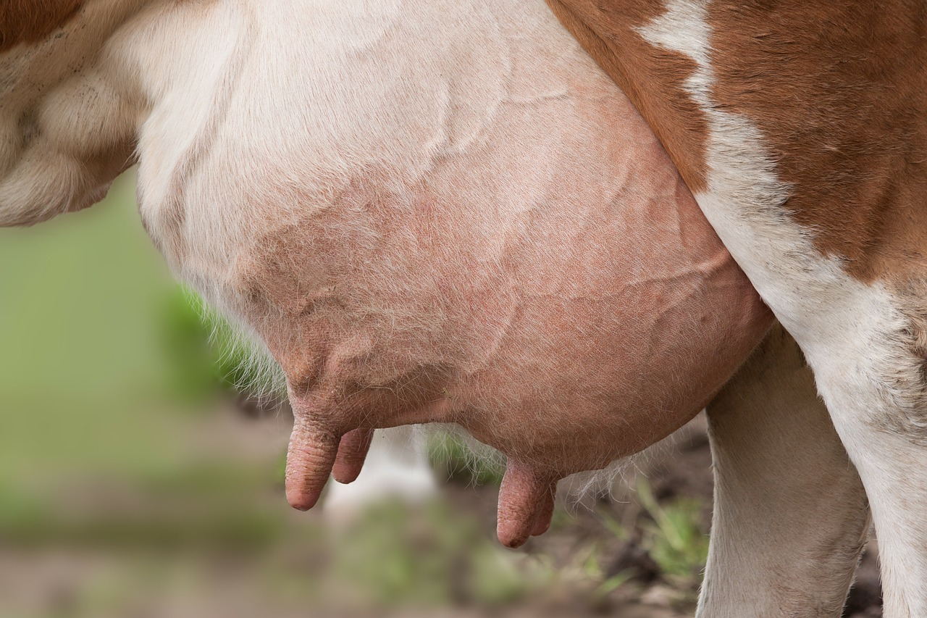
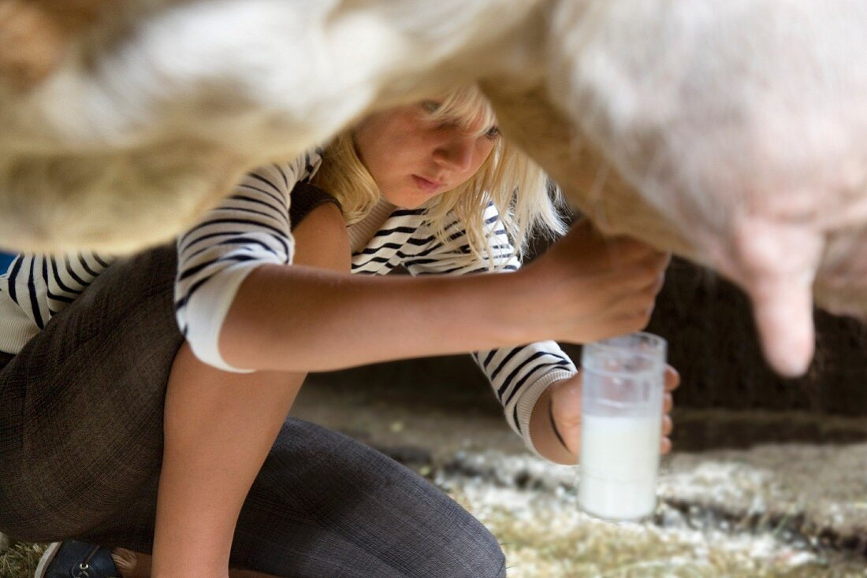
How do Pathogens get into the Raw Milk?
1. Systemic Sickness (Blood of Animal into Milk)
2. Mastitis (Utter Infection)
3. Fecal Contamination (From Animal into Milk)
4. Human Skin Contamination (From Humans touching Utter/Milk)

Slide 14
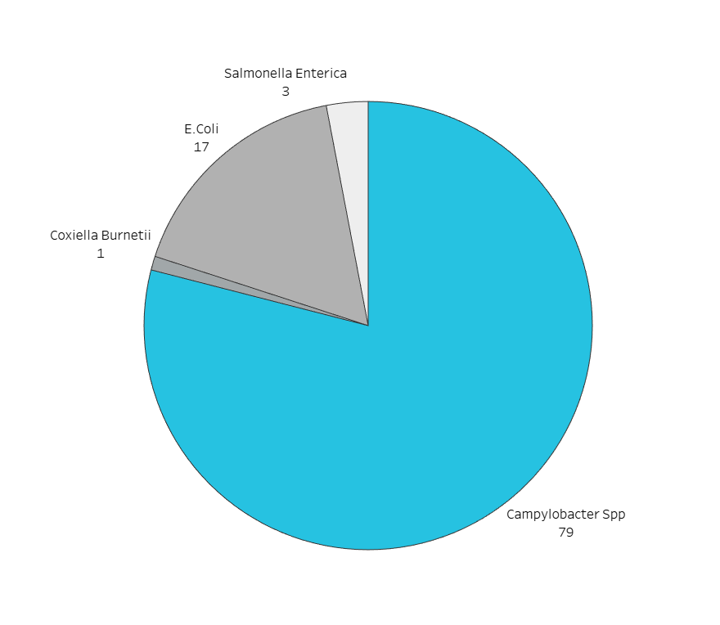
Illness Outbreak Type Percentage of Cases…
U.S. 2013-2018

Slide 15
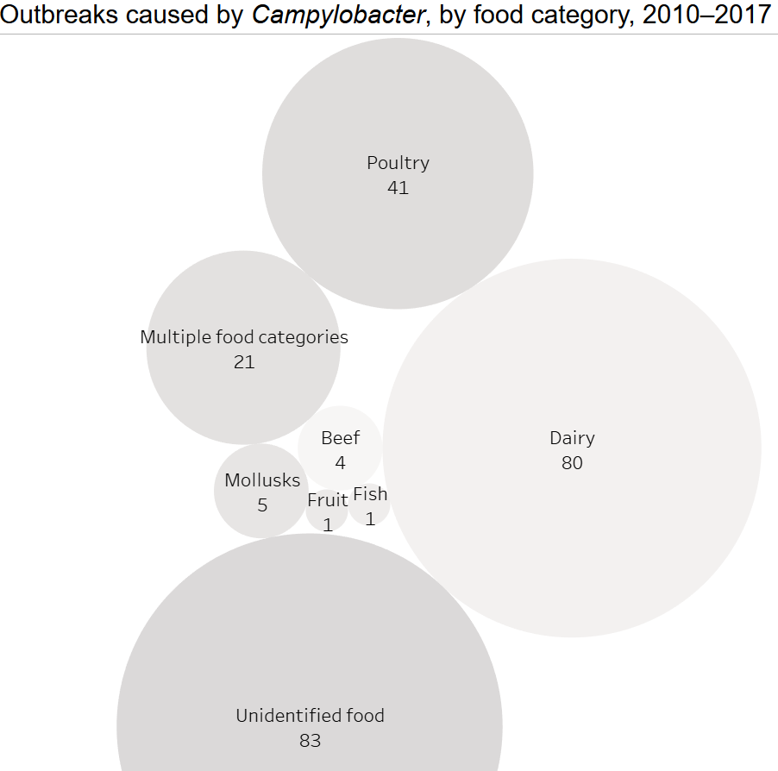
Campylobacter SPP Outbreaks:
Food Category
*
*
Bacterial infection for majority of raw milk outbreaks, illnesses, hospitalizations, and deaths.

Slide 16
U.S. Annual Food Illness Report for the 4 most common bacterial infections caused by raw milk…
4 most common bacterial infection for majority of raw milk outbreaks, illnesses, hospitalizations, and deaths.

Slide 17
Raw VS Pasteurized Nutritional Difference?
VITAMINS AND MINERALS

Slide 18
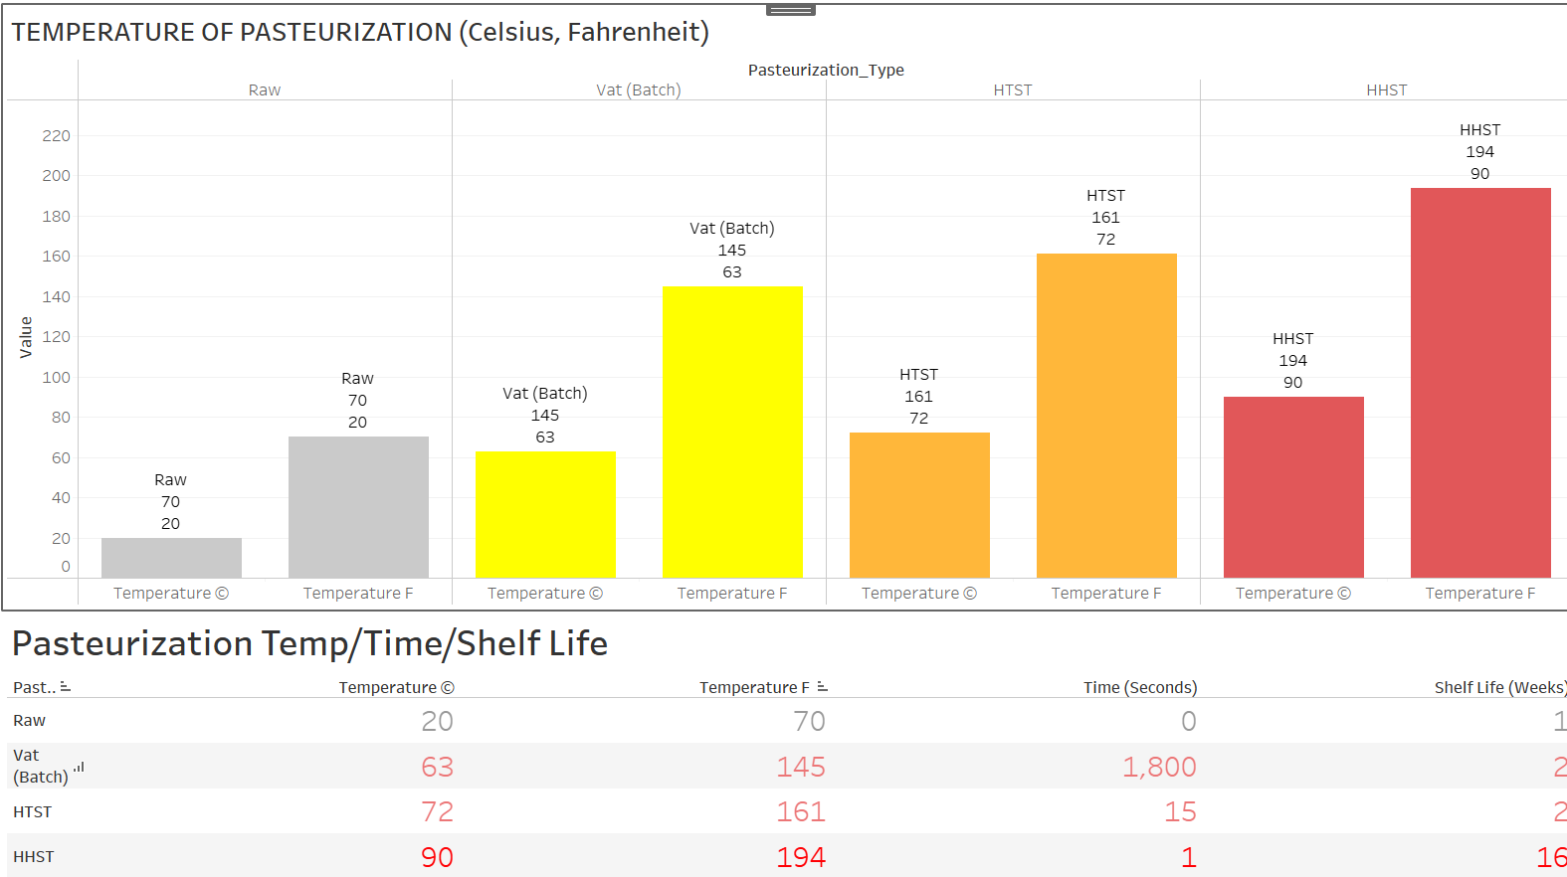
“Time And Temperature”…
The different ways dairy is pasteurized…
Vat (Batch) VS HTST (High Temp, Short Time) VS HHST (High Heat, Short Time)

Slide 19
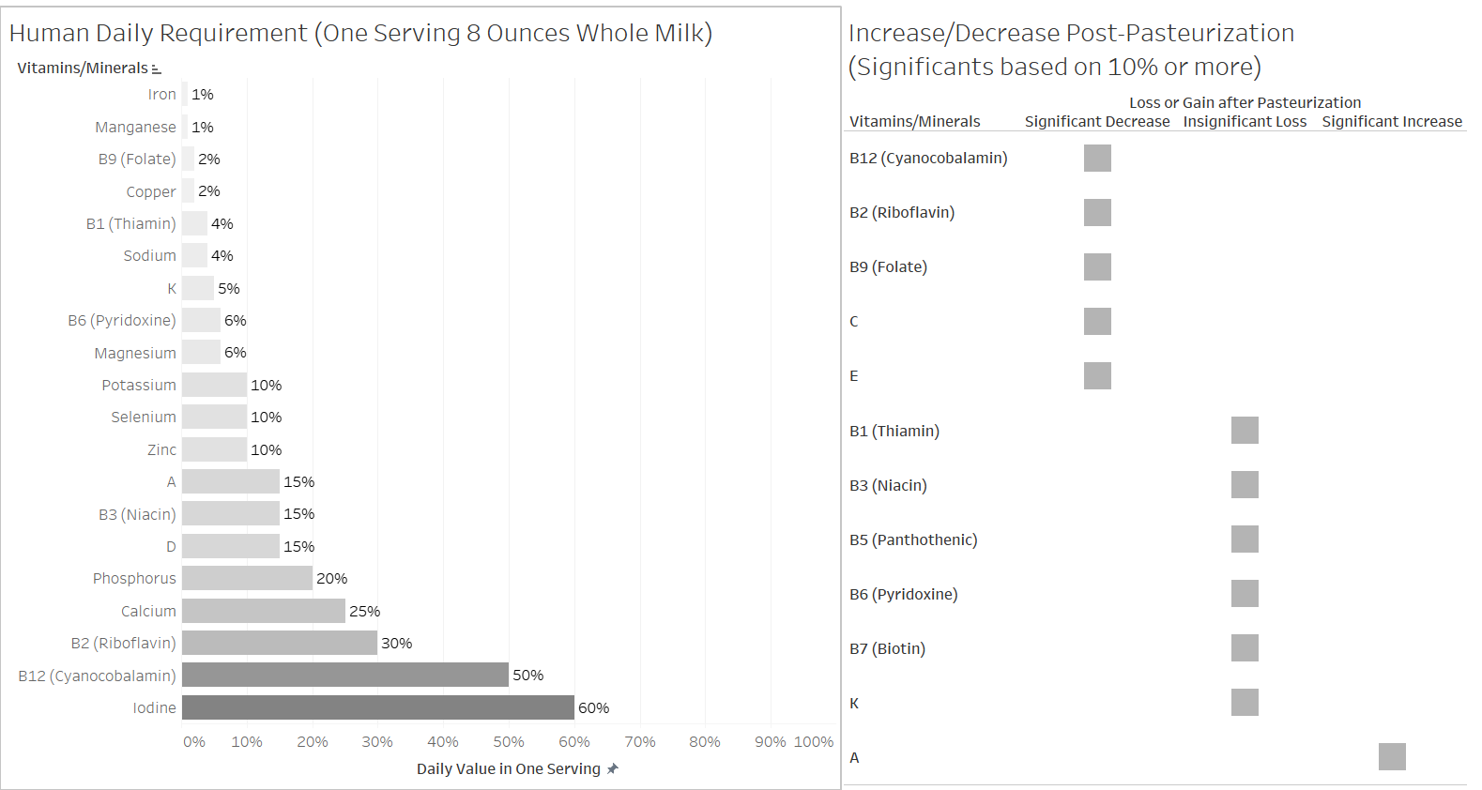
VITAMINS AND MINERALS

Slide 20
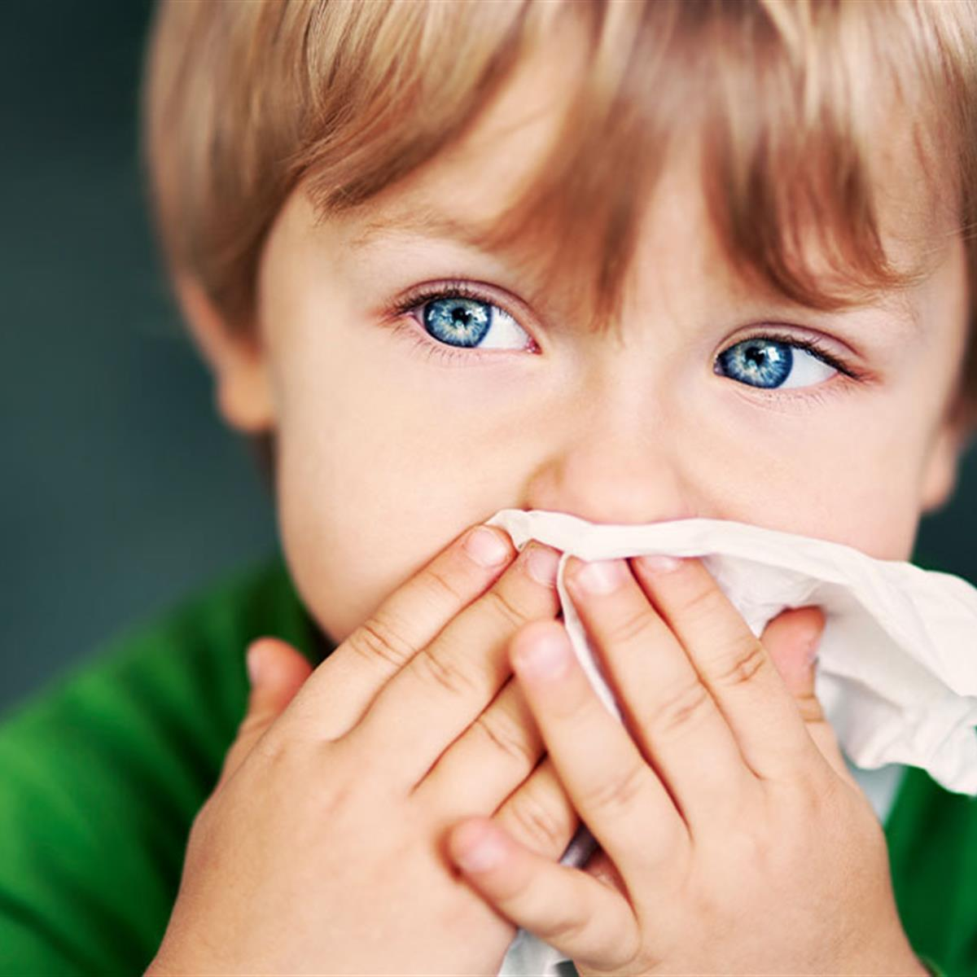
Healing Allergies?
Childhood Asthma/Allergies

Slide 21
Studies:
Dept. of Dairy Science, Royal Veterinary and Agricultural University, Copenhagen, Denmark. July 2003
E.-G. Samuelsson
Double Blind Study: 5 Children ages 12-40 months.
Orally administered- raw milk, pasteurized milk, homogenized milk, placebo (Nutramigen)
Skin prick test: significant and similar allergic reaction for all milk types. (Excluding Placebo)
Conclusion: All milk types similar reaction. No increase risk in development of respiratory allergies or atopic dermatitis. Developing children are inherently sensitive to food proteins. Cow’s milk can trigger immunoglobulin E-medicated reaction called CMA (Cow’s Milk Protein Allergy)

Slide 22
Studies:
Wageningen, Amersfoort, and Utrecht, Netherlands. October 2012
R. J. Joost van Neervan, PHD, Edward F. Knol, PHD
Early ingestion of unheated cow’s milk to children showing evidence of possible link between consumption of raw milk in first year of childhood development.
Conclusion: Raw milk contains many proteins and other constituents that might help in preventing asthma in infants and young children. However, findings might very well link the environment of living/being raised on a farm that could be a factor in the reduction of allergies in young developing children.

Slide 23
Conclusion:
Many variables in influencing the factors that make up early development of childhood asthma and allergies. More studies are needed.

Slide 24
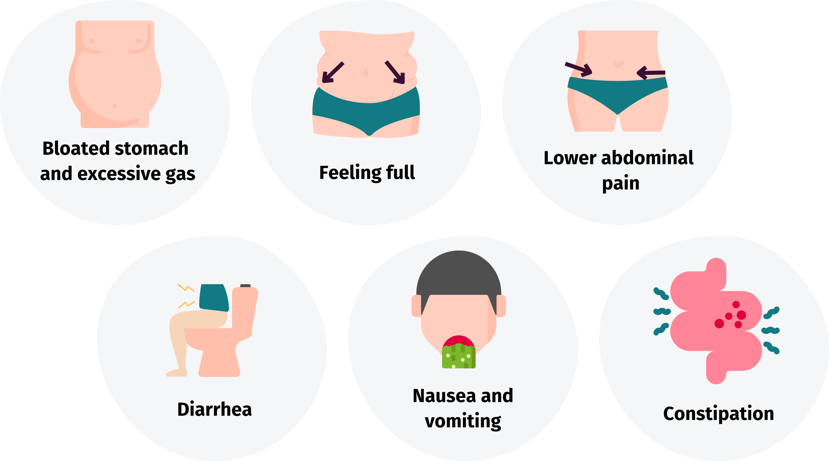
Lactose Intolerance Cure?
Raw Milk Enzymes

Slide 25
Studies:
Annals of Family Medicine. March 2014
Sarah Mumah, Mphil, Beibei Oelrich, MD, PhD, Jessica Hope, MSN, NP, Quyen Vu, BAH, and Christopher D. Gardner, PhD
16 Adults with self-reported lactose intolerance underwent 3 8-day milk phases (RAW VS PASTEURIZED VS SOY) in randomized order separated by 1 week washout periods. Steady daily increase from 118 ml to 710 ml of milk.
Conclusion: Raw milk failed to reduce lactose malabsorption or lactose intolerance symptoms compared to pasteurized milk. Symptom severities of lactose intolerance was HIGHER IN RAW MILK.

Slide 26
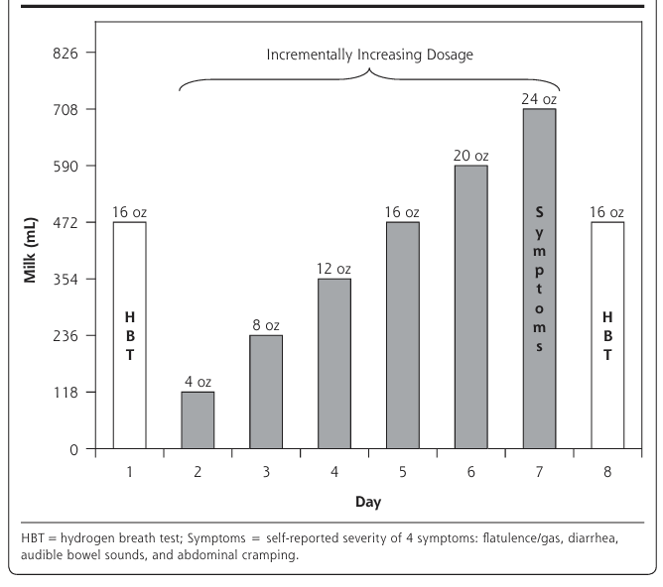
Milk dosage protocol for each phase. Amount of Milk consumed one sitting a day.

Slide 27
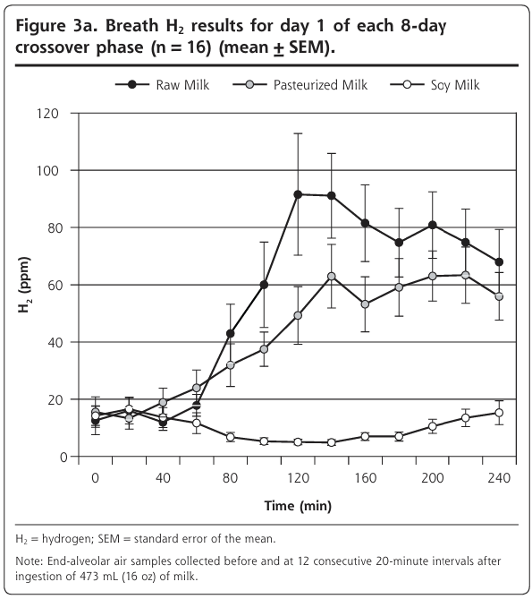
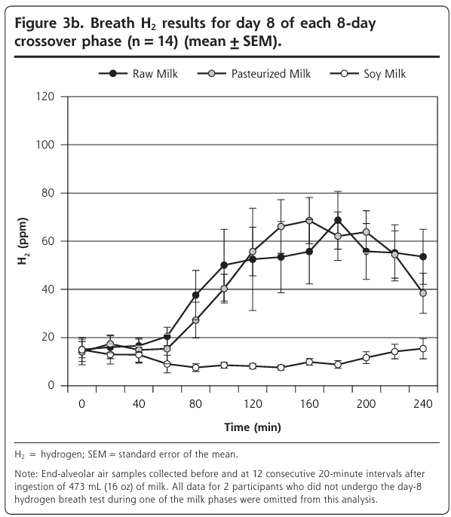
Lactose Intolerance Malabsorption Test (H2 Hydrogen Breath Testing)

Slide 28
Conclusion:
Because there is no ß-galactosidase enzymes in raw milk (deficiency in this enzyme causes lactose intolerance), there’s no reason why raw milk would assist in reduction of symptoms.

Slide 29
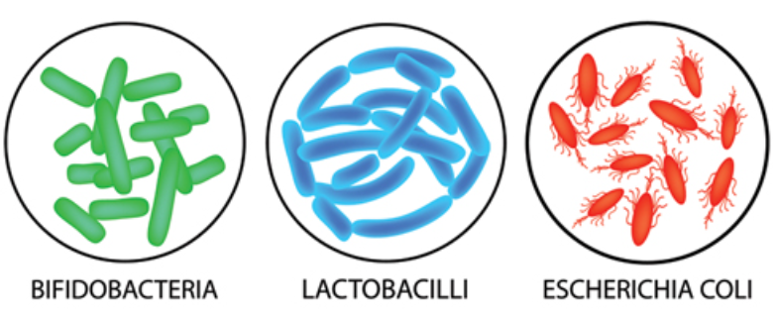
Beneficial Microflora in Raw Milk?
Good Bacteria in the Gut

Slide 30
The key (most beneficial) “good bacteria” (Bifidobacteria/Lactobacillus Acidophilus) are already in low levels in Raw Milk.

Slide 31
Conclusion:
“Most of the enzymes survive the pasteurization process.”
There are a number of potential antimicrobial systems in milk including lactoferrin, lactoperoxidase, lysozyme, bovine immunoglobulin, bacteriocins, oligosarccharides, and xanthine oxidase.
Lactoperoxidase and Lysozyme retain 70% or more of their activity after pasteurization. The rest of the systems listed above RETAIN ALL THEIR ACTIVITY, surviving the pasteurization process.

Slide 32
Final Conclusions:
Health risk is a risk but is very low (depending on age / immunocompromised).
Very little loss of nutrition (Vitamins/Minerals) in the pasteurization process.
Absence of Asthma and Allergies among developing children most likely linked to their living environment then drinking raw milk.
Lactose Intolerance symptoms remain the same (if not even more) when drinking raw milk (when compared to control groups pasteurized and soy)
Most Enzymes survive the Pasteurization Process.

