Slide 1
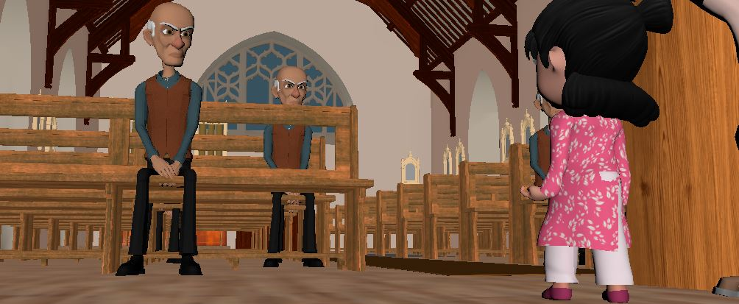
“BECOMING LIKE A CHILD

Slide 2
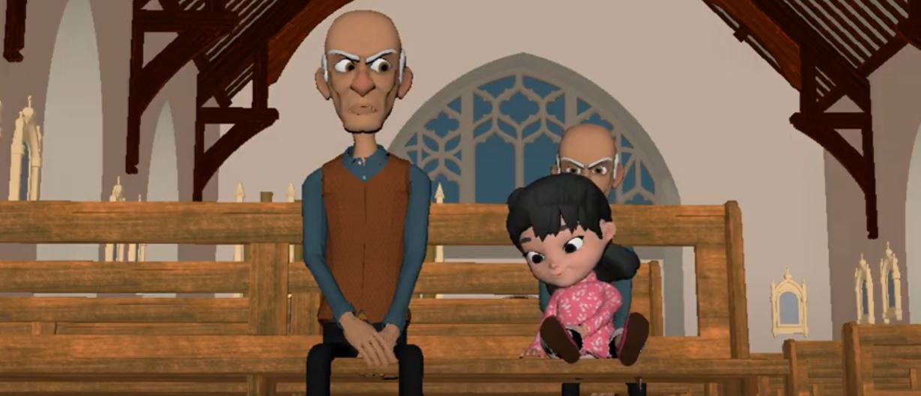
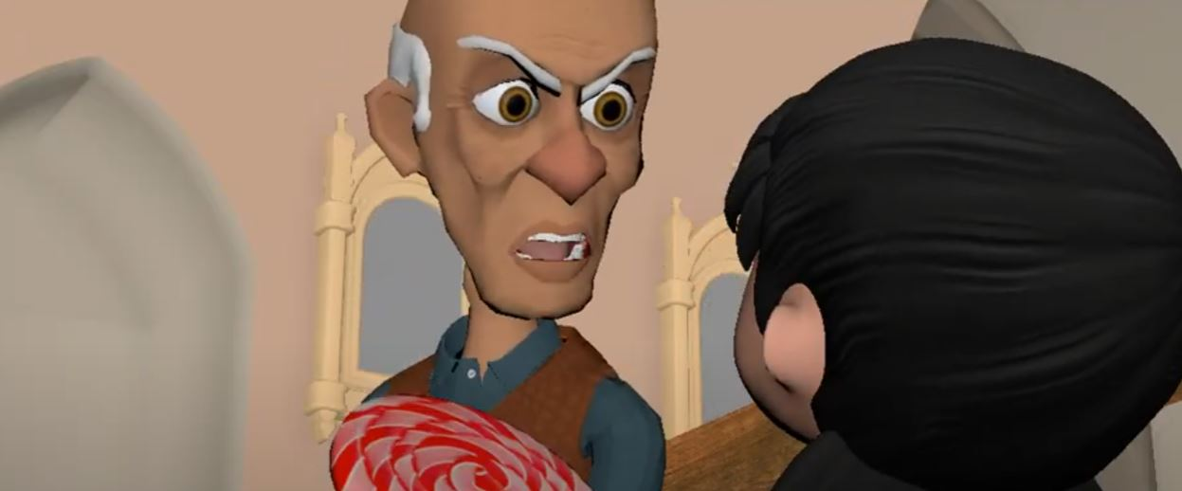
Semester 4 (Spring Semester 2022)
Shots 30-45 (Up to Hymnal)
Revised Animations
Adding nuances for Character Dev

Slide 3
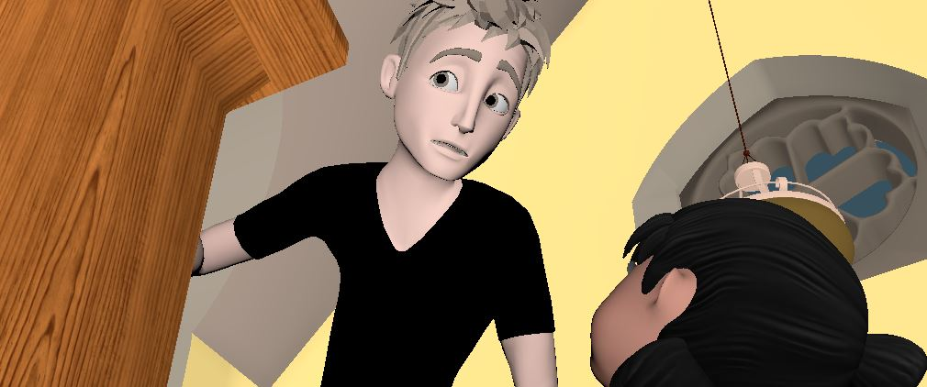
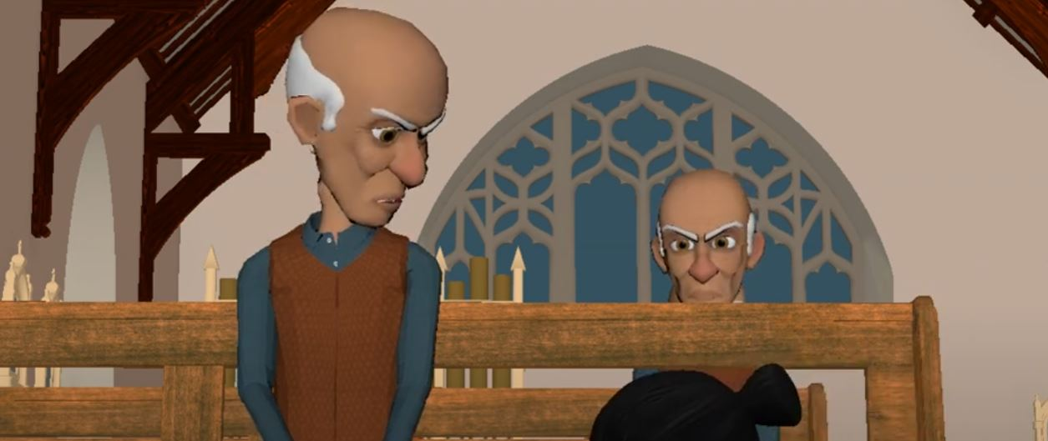
FINISHING
Fall Semester 2022
Finish to Ending.
Wig Fix Glitches.
Hardware-Based Lighting with Arnold.
Render.

Slide 4
CHALLENGES
Timing of movements too not be so rushed
Clone Workflows on the Hymnal Book.
Maya Glitchs with Hair

Slide 5
FIN

