Slide 1
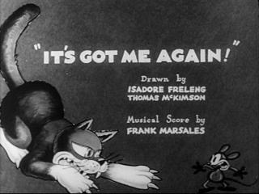
“IT’S GOT ME AGAIN!”
https://www.youtube.com/watch?v=zx62n_JIULE

Slide 2
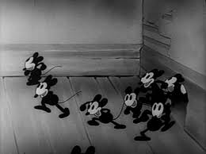
“IT’S GOT ME AGAIN”
Traditional Cell Animation
Directed by Rudolph Ising
1932
Warner Brother’s Pictures
One of the First of “Merrie Melodies”
7:09 minutes

Slide 3
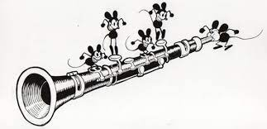
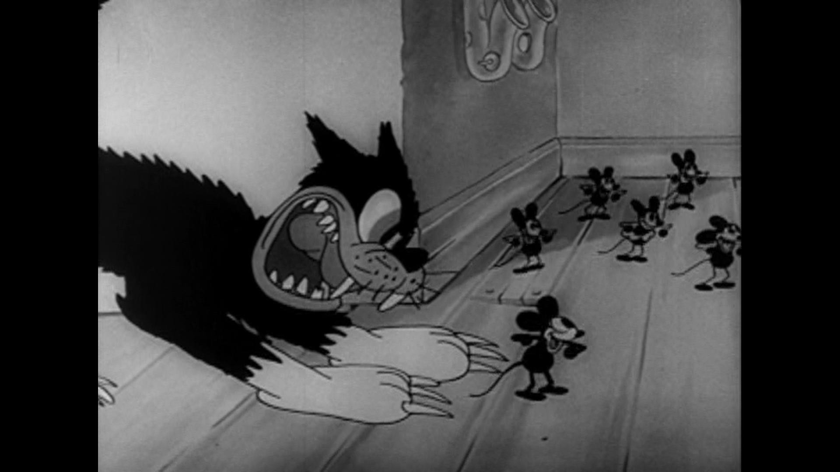
HISTORY
Based around the song “It’s Got Me Again” by Bernice Petkere, Lyrics by Irving Caesar
Animation by:
Isadore Freleng
Thomas McKimson
Black and White Cell Drawn Animation
Nominated:
1933 Academy Award Nomination for Best Short Subject (Cartoon)

Slide 4
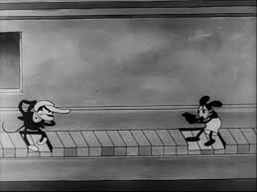
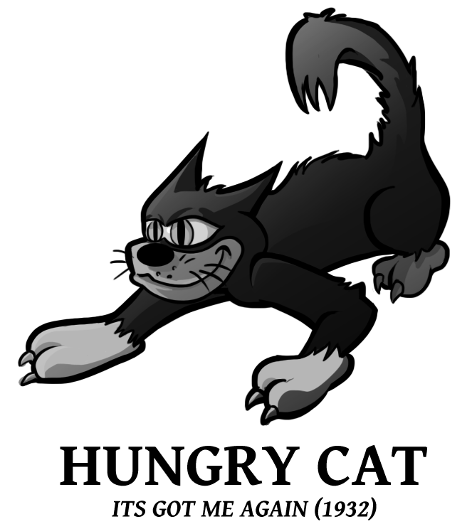
CHARACTERS
The Merry Mice
Looking for a good time.
Playful yet rowdy to each other.
Protective of each other.
The Hungry Cat
Vicious and merciless
Attacks and eats anything that looks like food (clock)
Evil

Slide 5
3 Act Structure
The other Mice attack the Hungry Cat with arrow drumsticks and
Lamp Flames, putting him on the run.
Setup
The Mouse Bypasses the Mouse Trap to wind up
The Gramophone.
Catalyst
The Music from the
Gramophone triggers a party of dancing by the emerging mouse
Turning Point
#1
The Hungry Cat makes his way into the house and reeks havoc. Chasing the head mouse.
Turning Point #2
The Hungry Cat corners the mouse in a corner where the mouse proclaims in song “It’s Got Me Again”
Climax
Final
Confrontation
Resolution
Act 1
All the Mice celebrate in Victory.
Using the Gramophone as a Machine Gun, they manage to scare the Hungry Cat, fleeing and jumping through a glass window to escape.
Act 2
Act 3

Slide 6
Circular Structure (It’s Got Me Again)
Character
Conflict
Motivation
Getting Rid of the Cat so the Party can continue.
The Mice wish to have a good old time with music and song while the owner of the house is away.
A Hungry Cat comes along and breaks up the party
Obstacles

Slide 7
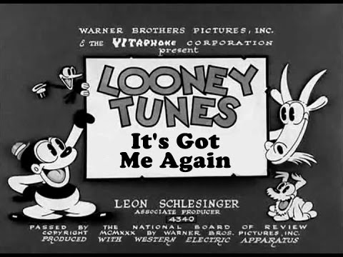
TECHNIQUE/ RECEPTION
Traditional Cell Animation.
Black and White
Awarded Nomination for Academy Award 1933

Slide 8
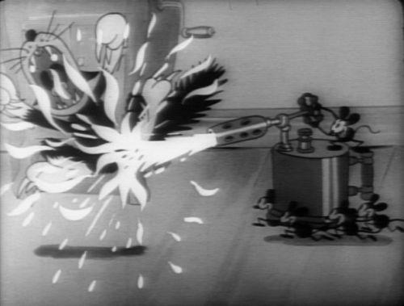
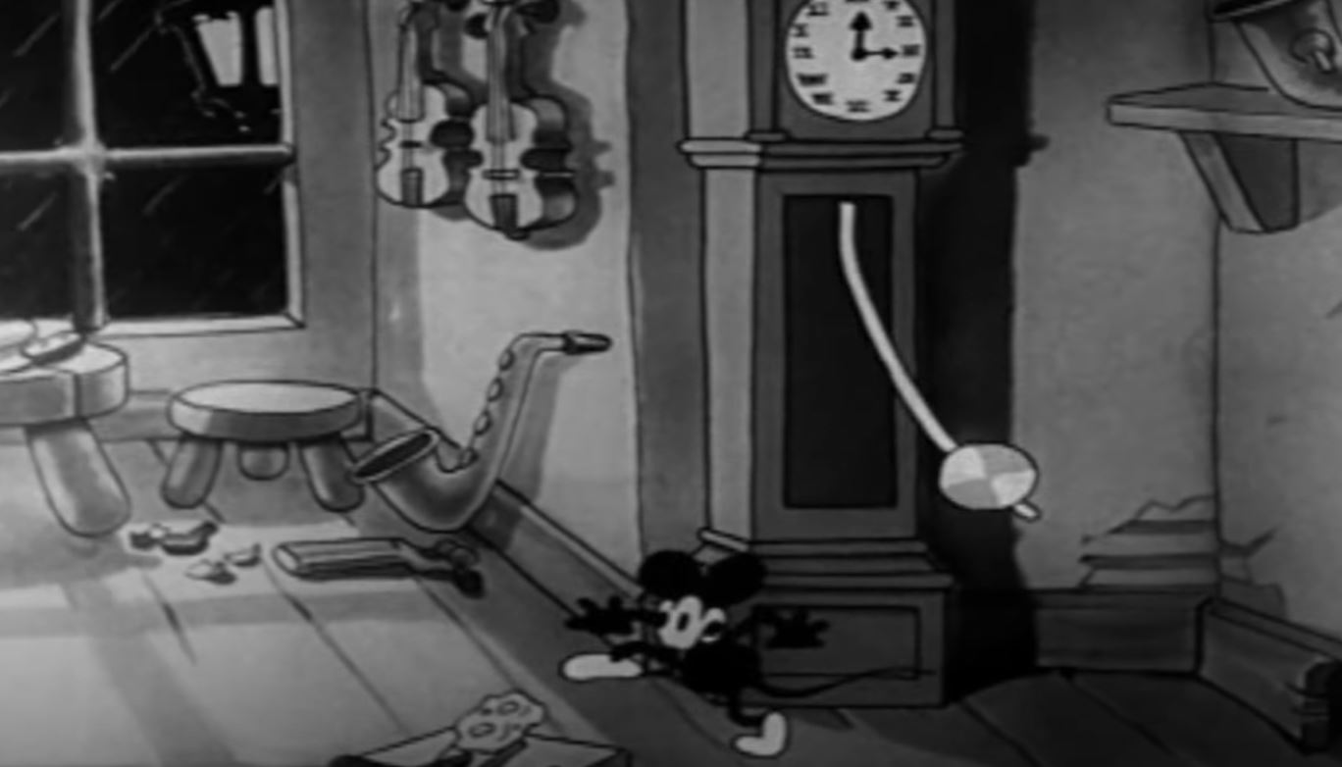
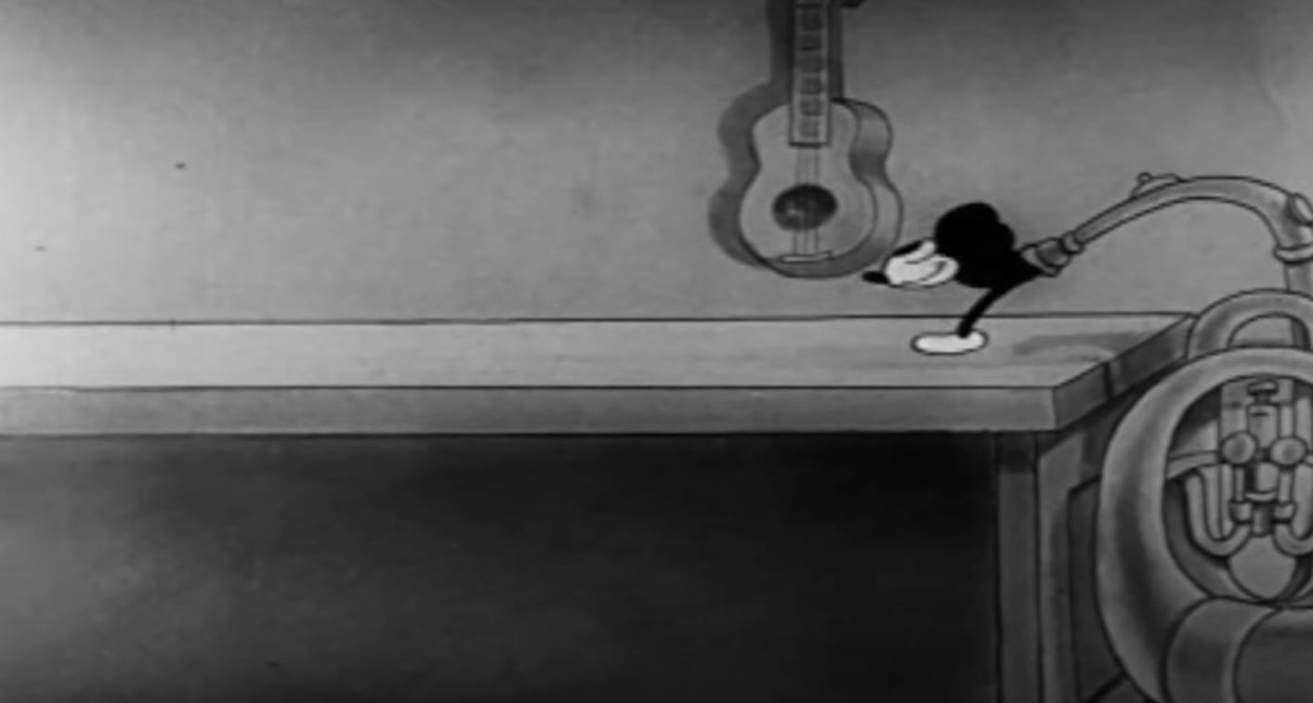
PRINCIPLES OF ANIMATION
Exaggeration
(Cat gets roasted)
6:33
Follow Through
(Swing of Grandfather Clock)
0:40
Squash and Stretch
(Mouse goes through the Tuba)
1:09

Slide 9
CONCLUSION/REVIEW

