Slide 1
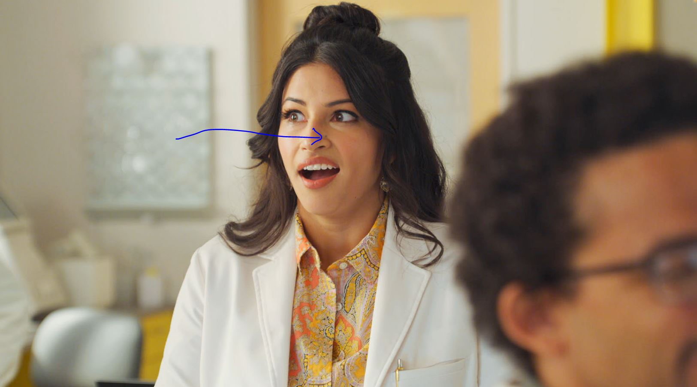
DEEP LEARNING TOOLSETS FOR VFX PRODUCTION
GETTING TO 100% AUTOMATION WITH TRUSTED RESULTS: ARE WE THERE YET?
PRESENTER: MATT SKONICKI

Slide 2
G. GUILIN, "Integrating Machine-Learning-Based Operators in Visual Effects Toolsets," in SMPTE Motion Imaging Journal, vol. 130, no. 5, pp. 26-34, June 2021, doi: 10.5594/JMI.2021.3072684.
REFERENCES:
Kleiman, Yanir, Simon Pabst, and Patrick Nagle. "Boosting VFX production with deep learning." ACM SIGGRAPH 2019 Talks. 2019. 1-2.
Korolov, Dmytro, et al. "Future of artificial intelligence and deep learning tools for VFX." ACM SIGGRAPH 2018 Panels. 2018. 1-2.
Dahlberg, Henrik, David Adler, and Jeremy Newlin. "Machine-learning denoising in feature film production." ACM SIGGRAPH 2019 Talks. 2019. 1-2.
Ricklefs, H., Puschendorf, S., Bhamidipati, S., Eriksson, B., & Pushparaja, A. (2017). From VFX project management to predictive forecasting. In ACM SIGGRAPH 2017 Talks (pp. 1-2).
Bermudez, L., Dabby, N., Lin, Y. A., Hilmarsdottir, S., Sundararajan, N., & Kar, S. (2021). A Learning-Based Approach to Parametric Rotoscoping of Multi-Shape Systems. In Proceedings of the IEEE/CVF Winter Conference on Applications of Computer Vision (pp. 776-785).
GUILIN LIU, FITSUM A. REDA, KEVIN J SHIH. (2018). IMAGE IMPAINTING FOR IRREGULAR HOLES USING PARTIAL CONVOLUTIONS
In CORNELL UNIVERSITY (pp. 1-9)

Slide 3
THESIS:
THE QUALITY LEVEL OF DEEP LEARNING TOOLSETS ARE STEADILY APPROACHING A LEVEL OF PRECISION, RELIABILITY, And WORKFLOW SPEED that, IN THE FUTURE, CAN BE IMPLEMENTED AT A FULL AUTOMATED CAPACITY; HOWEVER, CURRENT LIMITATIONS ON AVAILABLE DATASETS, GPU COMPUTING, and error results still show the need for human intervention in A.I. Workflows.

Slide 4
OPERATORS VS A.I. OPERATORS
OPERATORS HAVE AN INPUT, USE ALGORITHM, CREATE OUTPUT IMAGE
(USER PARAMETERS TWEAK RESULTS)
A.I. OPERATORS GO THROUGH EXTRA STEP OF TRAINING/MODEL BUILD
TWEAKING MODEL, CREATE OUTPUT IMAGE.
(USER PARAMETERS, IF PROVIDED, TWEAK RESULTS)

Slide 5
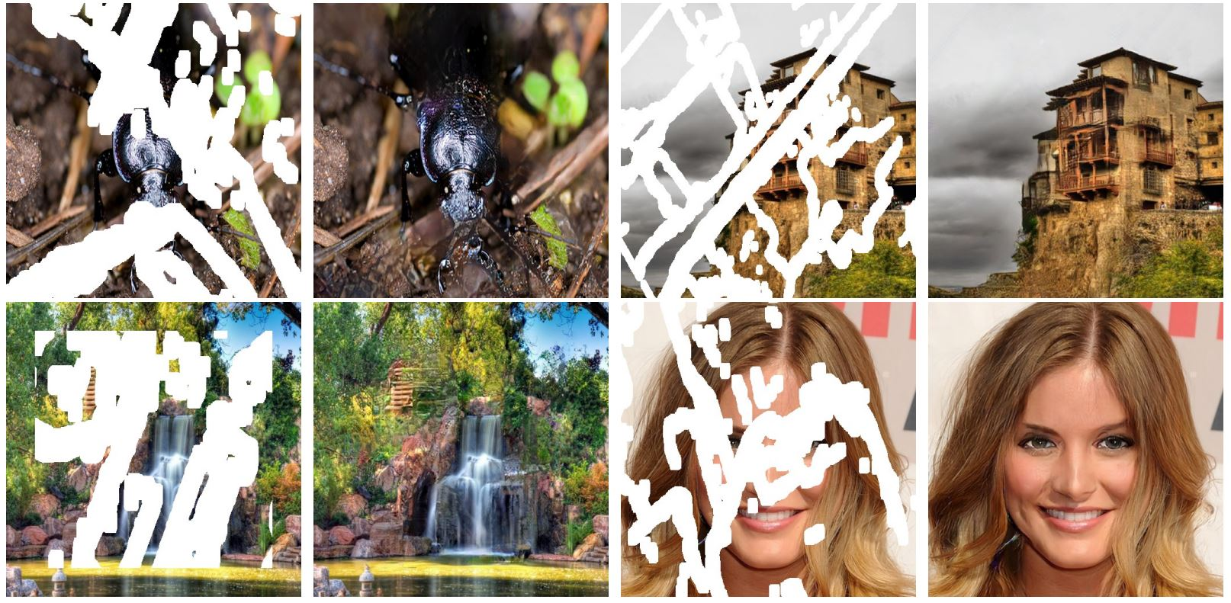
STUDY 1:
IMAGE PAINTING FOR IRREGULAR HOLES USING PARTIAL CONVOLUTIONS
PARTIAL CONVOLUTION NETWORKS
REPLACING STANDARD CONVOLUTION NETWORKS

Slide 6
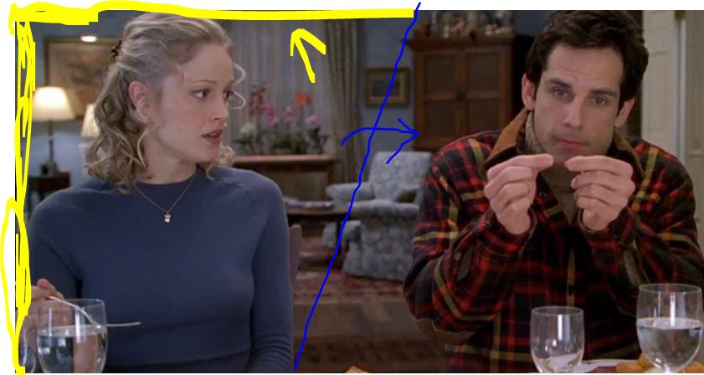
STUDY 1:
WHERE IS THIS BE USEFUL IN VFX COMPOSITING?
SPLITS: TWO DIFFERENT TEMPORAL PERFORMANCES STITCHED SIDE BY SIDE
ONE SIDE STABILIZED AND MATCHMOVED TO
PARENT SIDE
RECONTRUCTION OF MISSING DATA ON EDGES

Slide 7
STUDY 1:
IMAGE PAINTING FOR IRREGULAR HOLES USING PARTIAL CONVOLUTIONS
OLD STYLES OF Image inpainting
1. Used RECTANGULAR AREAS, USUALLY IN CENTER OF IMAGE
2. UseD POISSON IMAGE BLENDING AND FAST MARCHING

Slide 8
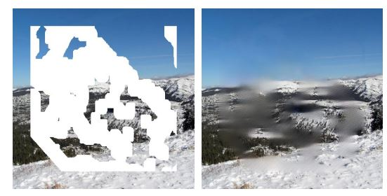
STUDY 1:
IMAGE PAINTING FOR IRREGULAR HOLES USING PARTIAL CONVOLUTIONS
OLD STYLES OF Image inpainting
BAD RESULTS: EXPENSIVE POST PROCESSING, NOT FULLY RESOLVING ARTIFACTS IN HOLES, OVERFITTING IN MODEL SOLVE

Slide 9
STUDY 1:
IMAGE PAINTING FOR IRREGULAR HOLES USING PARTIAL CONVOLUTIONS
SOLUTION: 2 layer process (for irregular shaped holes)
Masked/renormalized convolution operation
Followed by
An automatic mask-update

Slide 10
STUDY 1:
IMAGE PAINTING FOR IRREGULAR HOLES USING PARTIAL CONVOLUTIONS
TRAINING DATA: 27,000 IMAGES FOR TRAINING, 3000 for teSTING
IMAGES PROVIDED FROM:
IMAGENET DATASET (PLACES)
PLACES2 DATASET (PLACES)
CELEBA-HQ DATASET (PEOPLE)

Slide 11
STUDY 1:
IMAGE PAINTING FOR IRREGULAR HOLES USING PARTIAL CONVOLUTIONS
RESULTS: PRODUCTION Quality RESTORATIONS

Slide 12
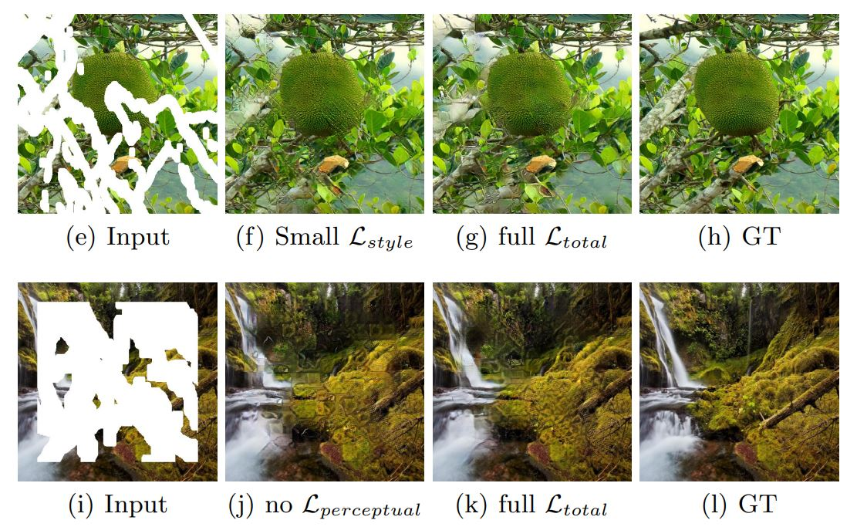

Slide 13
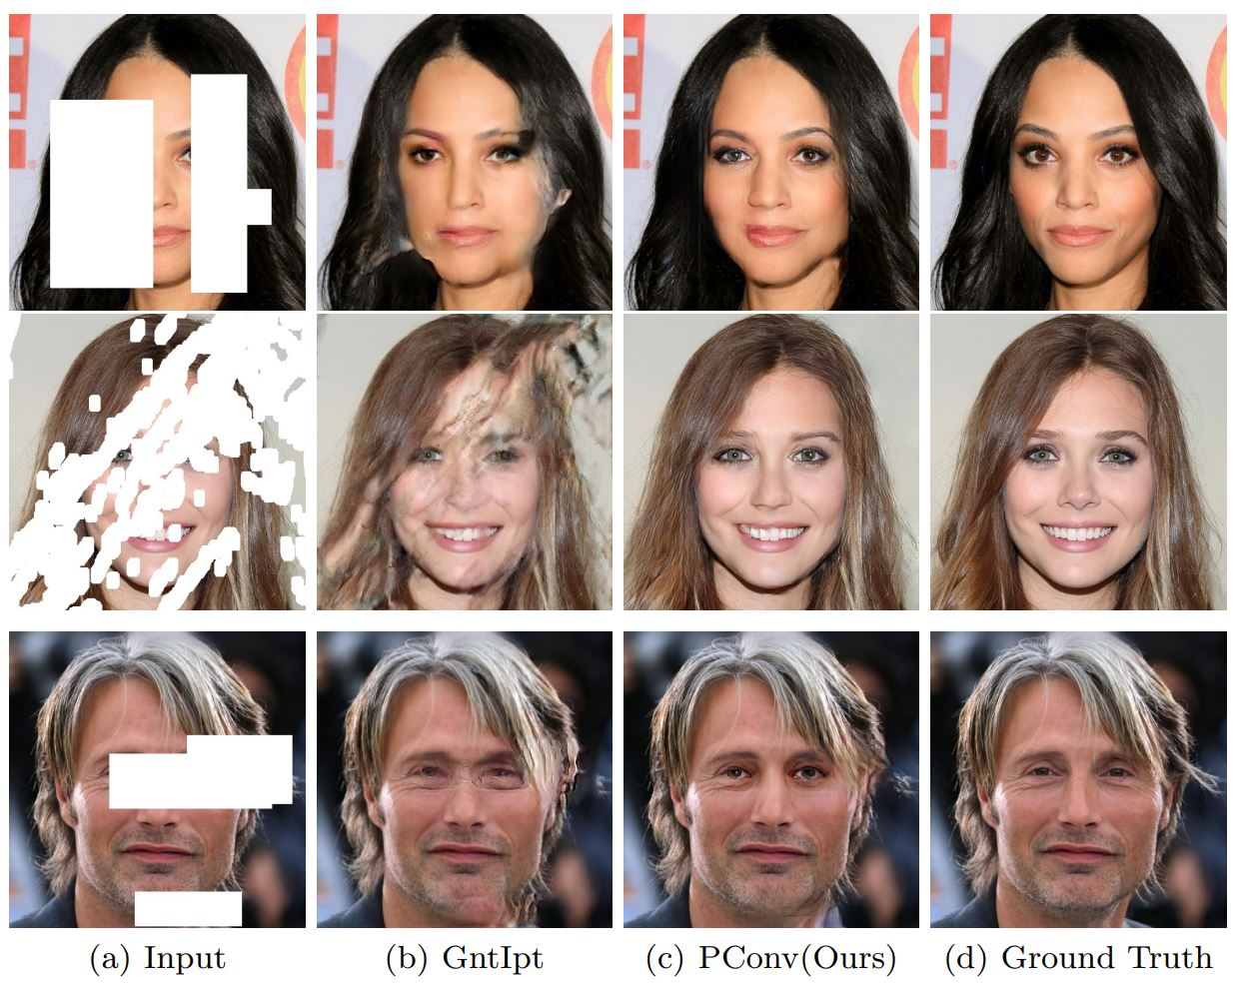

Slide 14
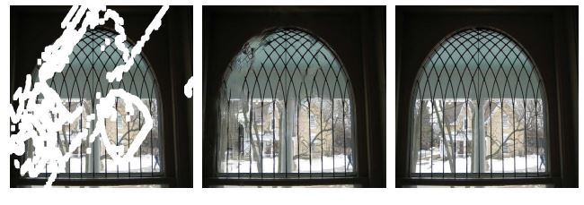
STUDY 1:
IMAGE PAINTING FOR IRREGULAR HOLES USING PARTIAL CONVOLUTIONS
FAILURES IN RARE SITUATIONS: PARSELY STRUCTURED IMAGES

Slide 15
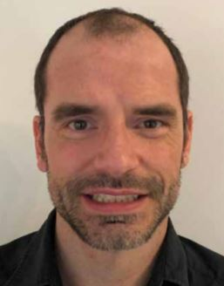
STUDY 2:
Integrating Machine-Learning-Based Operators in Visual Effects Toolsets
Creating PRODUCTION QUALITY UTILITY PASSES WITH
DEEP CONVOLUTION NEURAL NETWORKS (MACHINE LEARNING)
AUTODESK CREATIVE FINISHING TEAM-
LEAD BY NICOLAS MOENNE LOCCOZ

Slide 16
STUDY 2:
Integrating Machine-Learning-Based Operators in Visual Effects Toolsets
Creating PRODUCTION QUALITY UTILITY PASSES WITH
DEEP CONVOLUTION NEURAL NETWORKS (MACHINE LEARNING)
A.I. TOOLSETS:
USE FOR LIGHTING/BEAUTYIFICATION
DIGITAL GRADING

Slide 17
STUDY 2:
Integrating Machine-Learning-Based Operators in Visual Effects Toolsets
Creating PRODUCTION QUALITY UTILITY PASSES WITH
DEEP CONVOLUTION NEURAL NETWORKS (MACHINE LEARNING)
PROCESS:
CREATE DATA SET (PAIRS, SUPERVISED LEARNING)
Designing the model (LEARNED)
OPTIMIZING THE MODEL (MORE DATA SETS)
ANALYZE THE RESULTING TESTING DATA SET (MODIFY PARAMETERS)

Slide 18
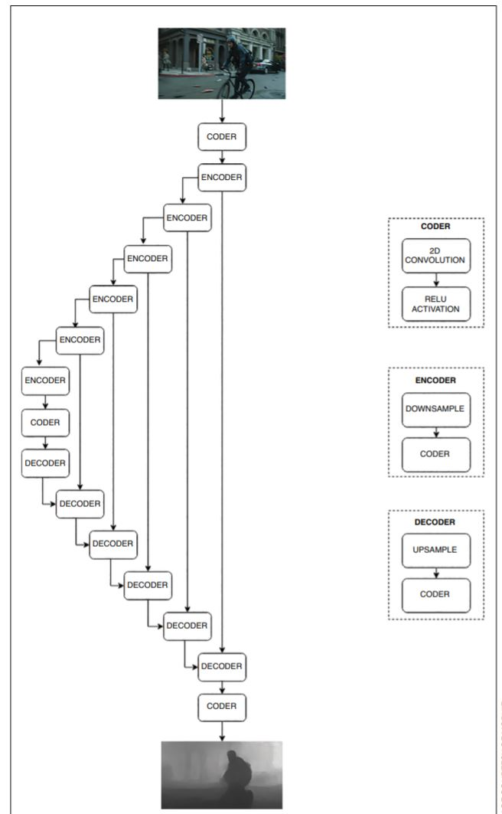
STUDY 2:
DCNN
(DEEP CONVOLUTIONAL NEURAL NETWORK)
SPACIAL DOWNSAMPLING DURING ENCODING
HIGH FREQUENCY CONTEXT IS RECOVERY BY UPSAMPLING DONE IN DECODING PROCESS

Slide 19
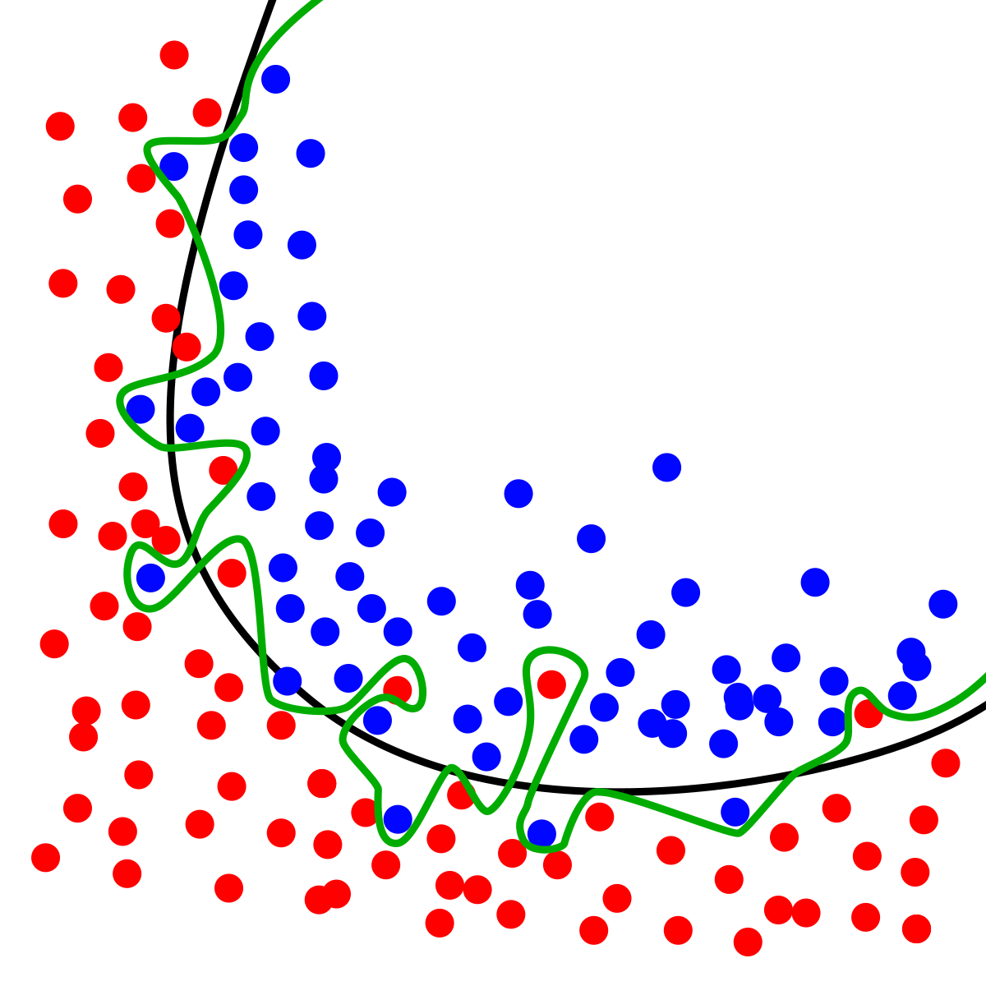
STUDY 2:
CAUSES OF OVERFITTING:
TOO SMALL TRAINING DATA SET
TOO HIGH MODEL CAPACITY

Slide 20
STUDY 2:
SKY SEGMENTATION OPERATOR
FEED A DATASET OF COMMON SKYS, THE MODEL DETECTS
WHAT IS SKY AND TRACES IT INTO A ROTOSCOPE (MICROSOFT COCO5 DATASET)
40,000 images of skies, defined by matte

Slide 21
STUDY 2:
DEPTH OPERATOR
FEED A DATASET PAIRS OF IMAGES WITH COURSE DEPTH
MAPS (MEGADEPTH DATASET)
100,000 image PAIRS

Slide 22
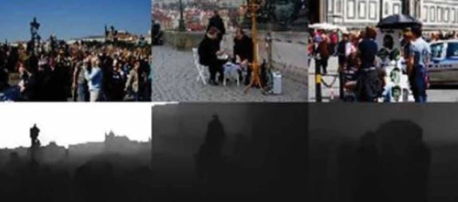
STUDY 2:
DEPTH OPERATOR
FEED A DATASET PAIRS OF IMAGES WITH COURSE DEPTH
MAPS (MEGADEPTH DATASET)
100,000 image PAIRS

Slide 23
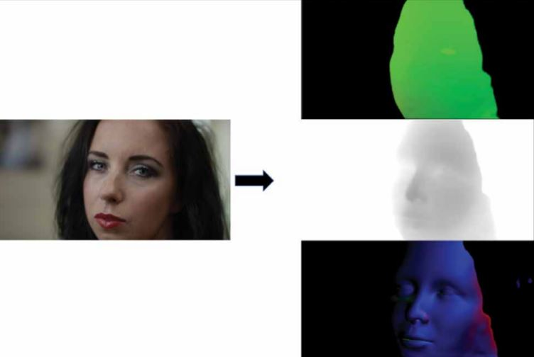
STUDY 2:
FACE MAP OPERATORS
FEED A DATASET PAIRS OF CG CHARACTERS WITH RENDERED
DEPTH, NORMAL, AND UV UTILITY RENDERS (NO REAL HUMANS USED)

Slide 24
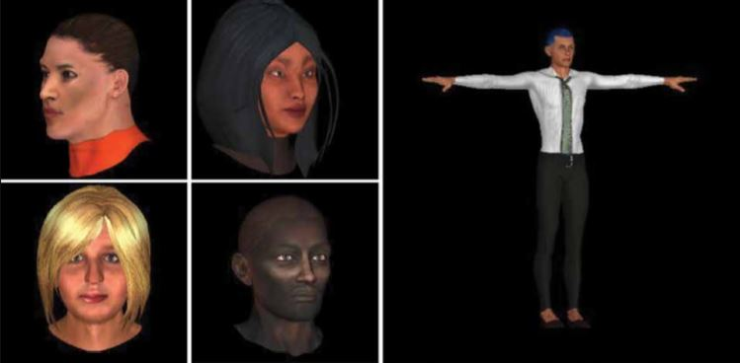
STUDY 2:
FACE MAP OPERATORS
FEED A DATASET PAIRS OF CG CHARACTERS WITH RENDERED
DEPTH, NORMAL, AND UV UTILITY RENDERS (NO REAL HUMANS USED)

Slide 25
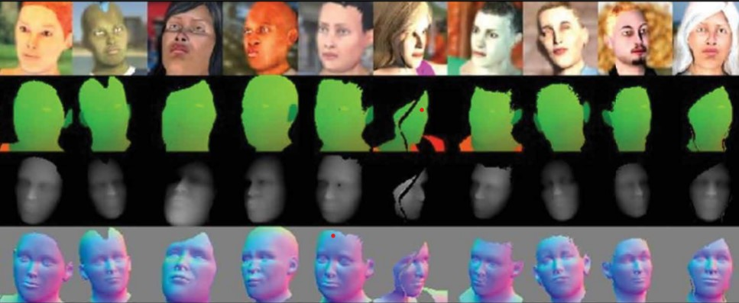
STUDY 2:
FACE MAP OPERATORS
FEED A DATASET PAIRS OF CG CHARACTERS WITH RENDERED
DEPTH, NORMAL, AND UV UTILITY RENDERS (NO REAL HUMANS USED)

Slide 26
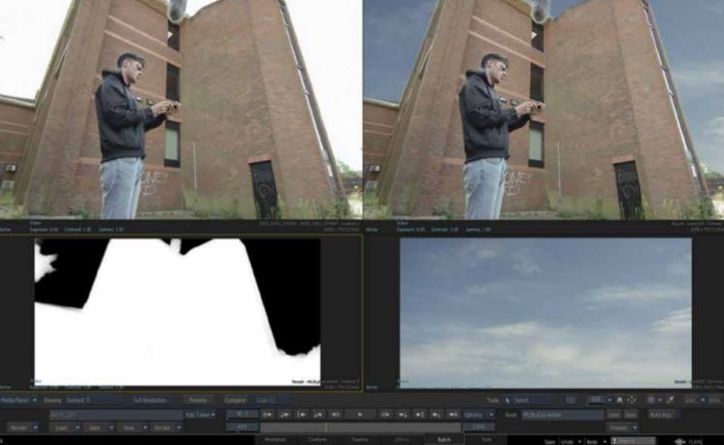
STUDY 2:
FINAL RESULTS:

Slide 27
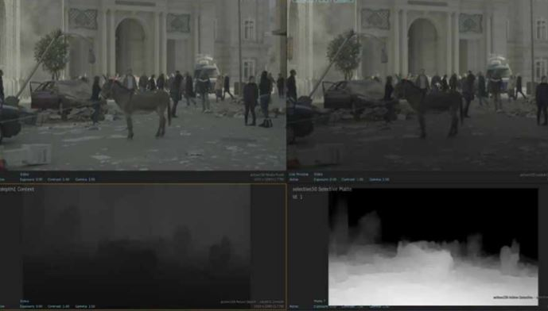
STUDY 2:
FINAL RESULTS:

Slide 28
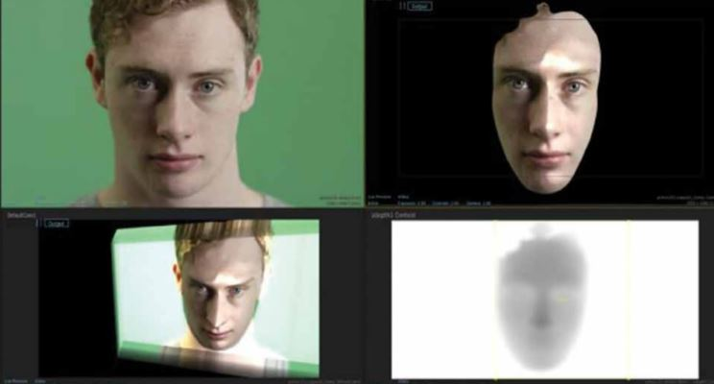
STUDY 2:
FINAL RESULTS:
RESULT: ALTHOUGH PICKS UP MEDIUM FREQUENCY DATA, REMAINS TOO COURSE FOR ACCURATE HIGH FREQUENCY DATA.

Slide 29
STUDY 2:
FINAL CONCLUSIONS:
LIMITATIONS:
RELY HEAVILY ON LARGE DATA SETS (PUBLICALLY AVAILABLE?)
VALIDATION IS DIFFICULT IN THE PROCESSING (NOISY GROUND TRUTHS)
SOMETIMES COMPLETELY FAILS WITH INPUT OF “USER CONTROLS”

Slide 30
STUDY 3:
BOOSTING VFX PRODUCTION WITH DEEP LEARNING
Creating PRODUCTION QUALITY UTILITY PASSES WITH
DEEP CONVOLUTION NEURAL NETWORKS (MACHINE LEARNING)
DOUBLE NEGATIVE (DNEG) TEAM
YANIR KLEIMAN, SIMON PABST, PATRICK NAGLE

Slide 31
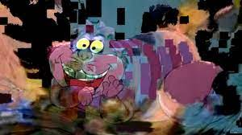
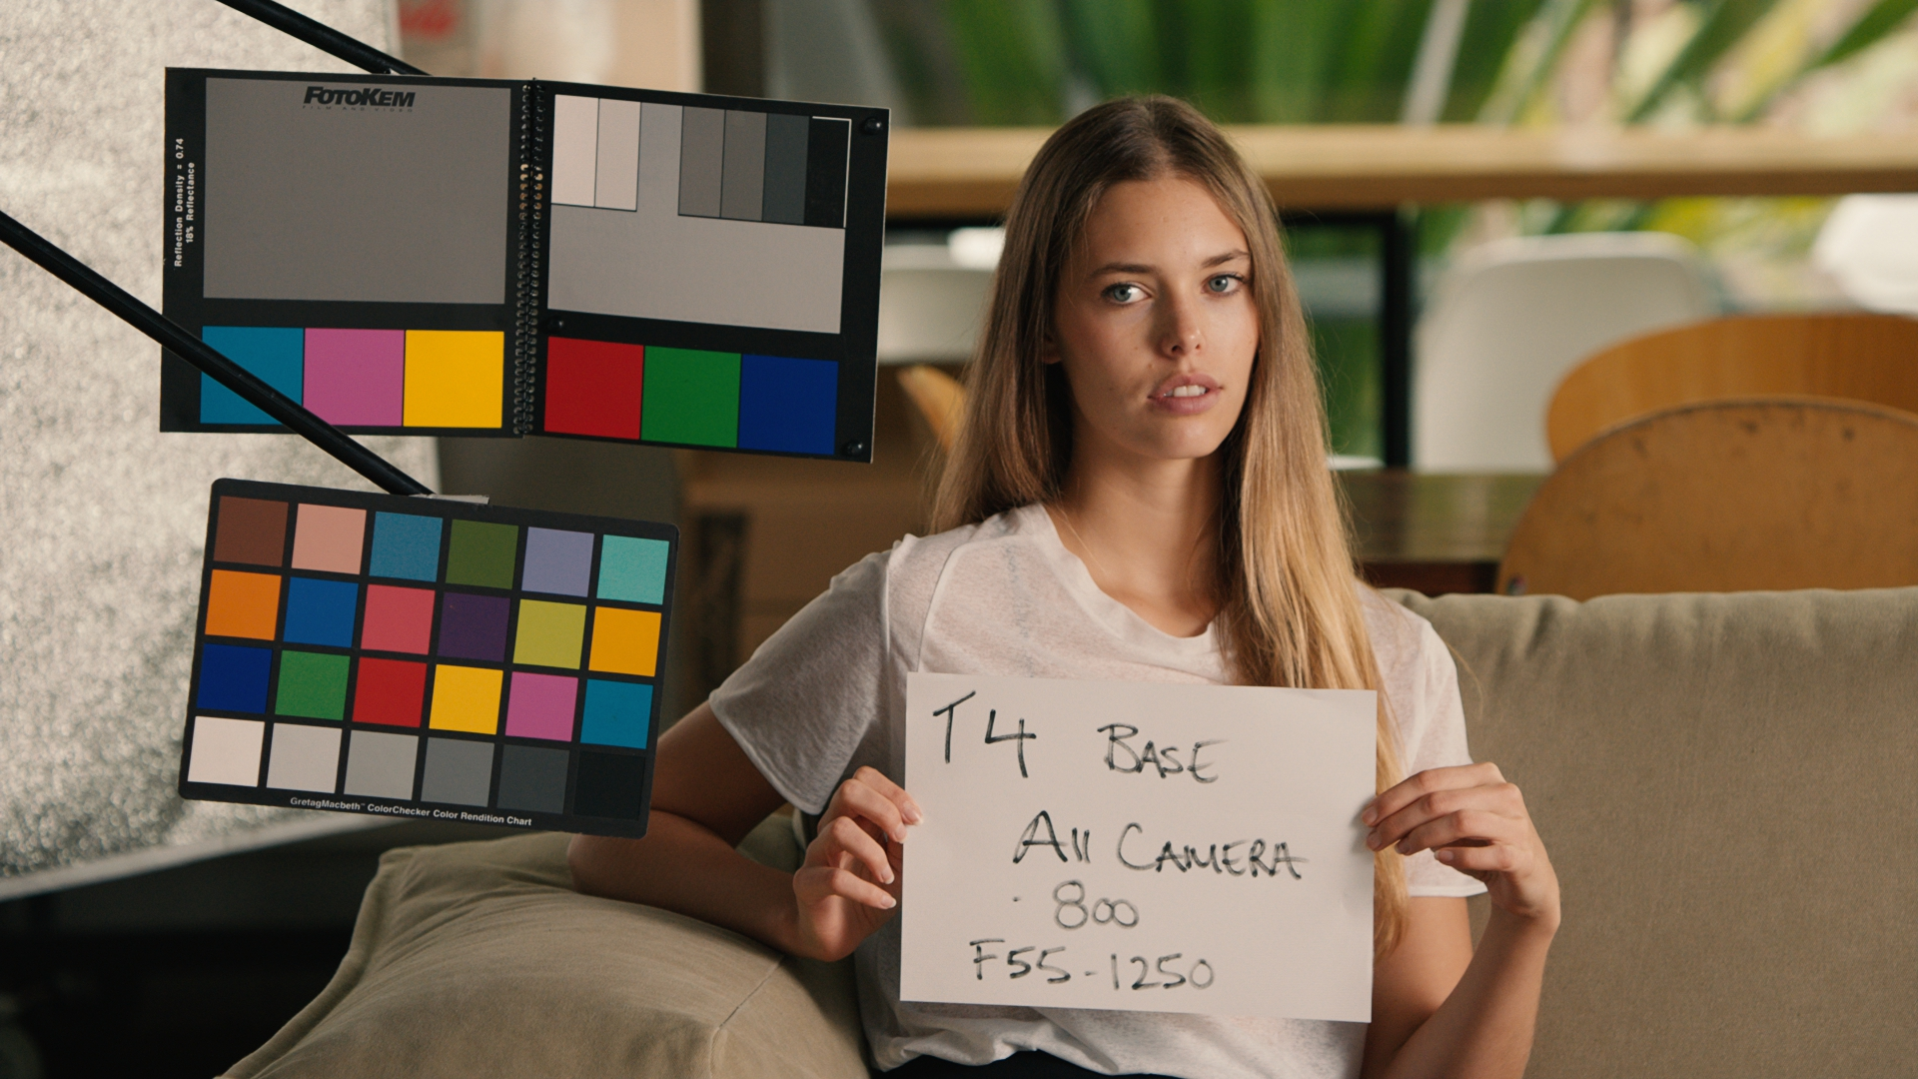
STUDY 3:
BOOSTING VFX PRODUCTION WITH DEEP LEARNING
VFX SOURCE MATERIAL RECEIVED FROM CLIENTS
PROBLEMS:
CLIENTS SEND OVER COMPRESSED FOOTAGE (HIGH QUALITY MPEG OR JPEG COMPRESSION)
LOCATING COLOR CHARTS FAST (SOMEWHERE IN FOOTAGE)

Slide 32
STUDY 3:
BOOSTING VFX PRODUCTION WITH DEEP LEARNING
DEALING WITH COMPRESSED FOOTAGE GIVEN OVER BY CLIENT
SOLUTIONS NEEDED:
REDUCE NOISE IN FOOTAGE
RECONSTRUCT DATA IN IMAGES LOST IN COMPRESSION

Slide 33
STUDY 3:
BOOSTING VFX PRODUCTION WITH DEEP LEARNING
DEALING WITH COMPRESSED FOOTAGE GIVEN OVER BY CLIENT
OLD SOLUTIONS:
MOVING HIGH FREQUENCY NOISE IN IMAGE-
PROBLEM- YOU CANNOT REPRODUCE LOST Elements:
SHARP DETAILS, REPEATED STRUCTURES

Slide 34
STUDY 3:
BOOSTING VFX PRODUCTION WITH DEEP LEARNING
4K COMPRESSED FILE WORKFLOW
24 X 24 PIXEL PATCH SEARCHES FOR SIMILAR PATTERN
NOW YOU HAVE DATASET PAIRS FOR LEARNING:
ORIGINAL 24 X 24 PATCH
FOUND SIMILAR 24 X 24 PATCH IN SAME IMAGE

Slide 35
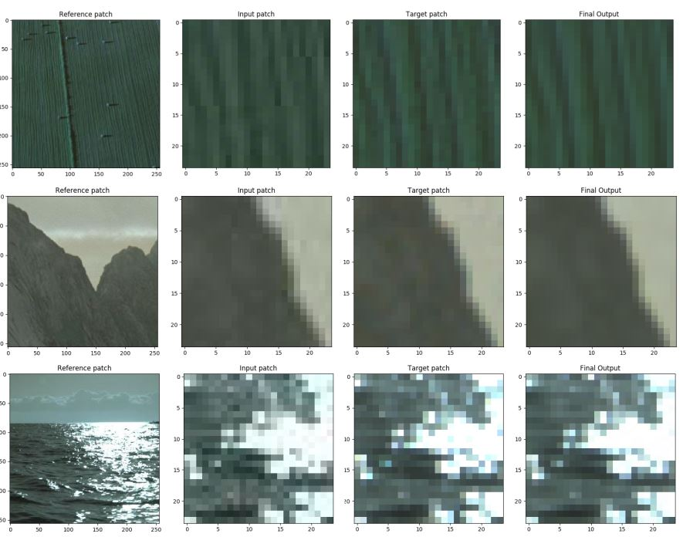

Slide 36
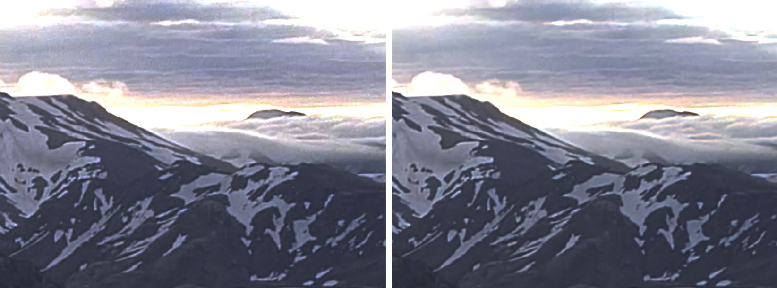
NOISE AND COMPRESSION (RINGING/BLOCKINESS) REDUCED DETAILS PRESERVED

Slide 37
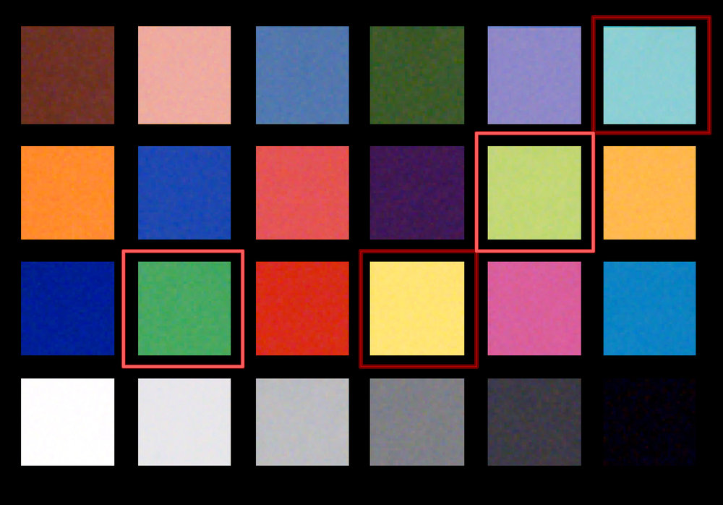
STUDY 3:
BOOSTING VFX PRODUCTION WITH DEEP LEARNING
WHERE’S WALDO: FINDING THAT SLATE IN THE FOOTAGE
TELL THE COMPUTEr TO “GO FETCH!”

Slide 38
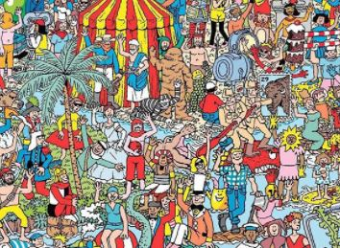
STUDY 3:
BOOSTING VFX PRODUCTION WITH DEEP LEARNING
CONVOLUTION NEURAL NETWORK:
FINDING WALDO (0 oR 1 RESULT)
Learns from 10,000 image library
Of color chart examples
(Different perspectives,
Fisheye lens, etc)

Slide 39
STUDY 3:
BOOSTING VFX PRODUCTION WITH DEEP LEARNING
CONVOLUTION NEURAL NETWORK:
1st STAGE IS FINDING WALDO (0 oR 1 RESULT)
HIGH ACCURACY RATE OF 99%
ON VALIDATION SET.

Slide 40
STUDY 3:
BOOSTING VFX PRODUCTION WITH DEEP LEARNING
DEEP LEARNING: NATURAL FIT FOR VFX PRODUCTION: DATA!!!
HIGH DEFINITION HDR IMAGES
BEFORE AND AFTER SHOTS
HIGH QUALITY RENDERS
PHOTOGRAMMETRY DATA

Slide 41
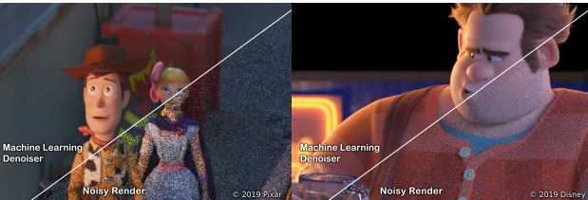
STUDY 4:
Machine learning (DENOISING) IN FEATURE FILM
PIXAr/ILM/WALT DISNEY (HENRIK DAHLBERG, DAVID ADLER, JEREMY NEWLIN)

Slide 42
STUDY 4:
Machine learning (DENOISING) IN FEATURE FILM
PATH-TRACED MONTE CARLO RENDERING-
NOISE CAUSED FROM RANDOM SAMPLING OF LIGHT PATHS

Slide 43
STUDY 4:
Machine learning (DENOISING) IN FEATURE FILM
THE MACHINE LEARNING PROCESS TO
CLEAN UP THE RENDERS
STAGE 1: DENOISE THE PLATE
DENOISE INDIVIDuAL PASSES (COLOR,DIFFUSE,SPECULAR, ALPHA)
1. TEMPORAL DENOISE: (DIFFERENT FRAMES COMPARED)
2. SpaCIAL DENOISE: USING VECTORS TO WARP FOOTAGE INTO COMPARISON PATCH AREA

Slide 44
STUDY 4:
Machine learning (DENOISING) IN FEATURE FILM
THE MACHINE LEARNING PROCESS TO
CLEAN UP THE RENDERS
STAGE 2: TIME TO LEARN FOR CREATED DATASET PAIRS
COMPARING TWO THINgS:
ORIGINAL NOISY INPUT
DENOISED GROUND TRUTH

Slide 45
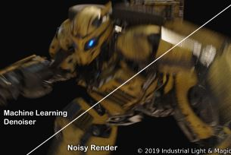
STUDY 4:
Machine learning (DENOISING) IN FEATURE FILM

Slide 46
STUDY 4:
Machine learning (DENOISING) IN FEATURE FILM
POSITIVE AND NEGATIVES
+ FEWER ARTIFACTS THEN OLD TECHNIQUES
+ SAVES COMPUTING TIME (2 to 4 times faster)
+ REDUCING “FIREFLY” removal by compositors
- OVERSMOOTING OCCURS IN HIGH FREQUENCY DAta
AVOIDED HOWEVER BY HIGH RESOLUTION RENDERS AND PARAMETER ADJUSTMENT OF DENOISE INTENSITY PER SHOT

Slide 47
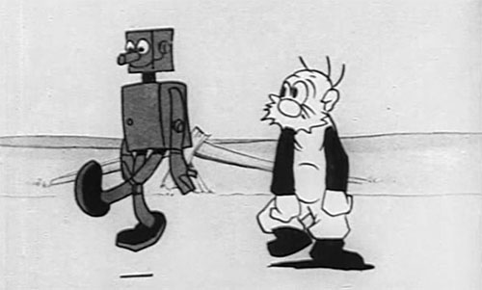
STUDY 5:
A.I. FOR PROJECT MANAGEMENT
MPC (MOVING PICTURES COMPANY)
HANNES RICKLEFS, STEFAN PUSCHENDORF
“FOLLOW ME”
A.I. LEADING THE WAY FOR
PREDICTIVE FORECASTING
IN VFX Production

Slide 48
STUDY 5:
A.I. FOR PROJECT MANAGEMENT
MPC (MOVING PICTURES COMPANY)
HANNES RICKLEFS, STEFAN PUSCHENDORF
“FOLLOW ME”
A.I. LEADING THE WAY FOR
PREDICTIVE FORECASTING
IN VFX Production

Slide 49
STUDY 5:
A.I. FOR PROJECT MANAGEMENT
INPUT: PERFORMANCE ANALYTICS, DATA SUMMARYS
OUTPUT: PREDICTIVE ANALYTICS, PROCESS CONTROLLING/FORECASTS
MPC- THOUSAND OF EMPLOYEES
SATELLITE STUDIOS AROUND
THE GLOBE.

Slide 50
STUDY 5:
A.I. FOR PROJECT MANAGEMENT
INPUT: PERFORMANCE ANALYTICS, DATA SUMMARYS
OUTPUT: PREDICTIVE ANALYTICS, PROCESS CONTROLLING/FORECASTS
INGEST PRODUCTION DATA
AGGREGATION OF STATS (LEVELS)

Slide 51
STUDY 5:
A.I. FOR PROJECT MANAGEMENT
INPUT: PERFORMANCE ANALYTICS, DATA SUMMARYS
OUTPUT: PREDICTIVE ANALYTICS, PROCESS CONTROLLING/FORECASTS
GOAL:
CREATE HOLISTIC INSIGHTS
OF DIFFERENT SEGMENTS OF THE
MPC BUSINESS

Slide 52
STUDY 5:
A.I. FOR PROJECT MANAGEMENT
INPUT: PERFORMANCE ANALYTICS, DATA SUMMARYS
OUTPUT: PREDICTIVE ANALYTICS, PROCESS CONTROLLING/FORECASTS
REAL-TIME PREDICTIVE ANALYTICS PIPELINE: (TRAINED MODELS)
73% ACCURACY RATE TO PREDICT IF SPECIFIC TASKS WILL OVERSPEND

Slide 53
STUDY 5:
A.I. FOR PROJECT MANAGEMENT
INGESTIONS/PREDICTION MODEL

Slide 54
STUDY 5:
A.I. FOR PROJECT MANAGEMENT
INGESTIONS/PREDICTION MODEL
MEASURES:
OVERSPEND
OVERTIME
PERFORMANCE
JOB DURATION

Slide 55
STUDY 5:
A.I. FOR PROJECT MANAGEMENT
INGESTIONS/PREDICTION MODEL
THE GROUND TRUTH “TRAINING DATA SETs” ARE PREVIOUS
PRODUCTIONS (JOB COMPLETION DATA, TIMELINE DATA)
THE CURRENT PRODUCTIONS ARE THE “TESTING DATA SET”

Slide 56
STUDY 5:
A.I. FOR PROJECT MANAGEMENT
INGESTIONS/PREDICTION MODEL
EXAMPLE DATA SET FOR CURRENT PRODUCTION SCHEDULE
IF THE CURRENT TESTING DATA SET IS COMPARABLE To OVERTIME GROUND TRUTH (BAD NEWS, JOB WILL REQUIRE OVERTIME)
IF THE CURRENT TESTING DATA COMPARABLE TO NO OVERTIME GROUND TRUTH (GOOD NEWS, JOB WILL BE DONE ON TIME)

Slide 57
STUDY 5:
A.I. FOR PROJECT MANAGEMENT
RESULTS:
73.25% PREDICTIVE ACCURACY
FUTURE PREDICTIVE INTEGRATIONS: ASSET MANAGEMENT, RESOURCE PLANNING, RENDER AND DATA CONSUMPTION.

Slide 58
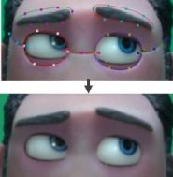
STUDY 6:
A LEARNING-BASED APPROACH TO PARAMETRIC
ROTOSCOPING OF MULTI-SHAPE SYSTEMS
LUIS BERMUDEZ, NADINE DABBY
(INTEL CORPORATION)
LIMITED (FACIAL) AUTOMATED
ROTOSCOPing
EXAMPLE:
LAIKA STUDIOS
STOP ACTION ANIMATION CHARACTER FOOTAGE

Slide 59
STUDY 6:
A LEARNING-BASED APPROACH TO PARAMETRIC
ROTOSCOPING OF MULTI-SHAPE SYSTEMS
INSTEAD OF USING CLAY
POP ON AND OFF DIFFERENT EXPRESSIONS ON THE CHARACTER
(3D PRINTED FACE PARTS)

Slide 60
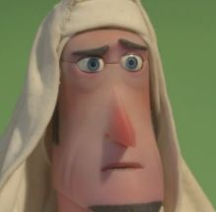
STUDY 6:
A LEARNING-BASED APPROACH TO PARAMETRIC
ROTOSCOPING OF MULTI-SHAPE SYSTEMS
SEAMS/CHATTER NEED TO BE REMOVED

Slide 61
STUDY 6:
A LEARNING-BASED APPROACH TO PARAMETRIC
ROTOSCOPING OF MULTI-SHAPE SYSTEMS
Two
learned models used

Slide 62
STUDY 6:
A LEARNING-BASED APPROACH TO PARAMETRIC
ROTOSCOPING OF MULTI-SHAPE SYSTEMS
SEMATIC FOCUS:
DETECTING FACIAL FEATURE WHICH in TURN
CREATES A ROADMAP TO THE PROBLEMATIC SEAMS

Slide 63
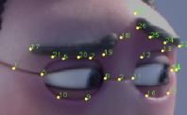
STUDY 6:
A LEARNING-BASED APPROACH TO PARAMETRIC
ROTOSCOPING OF MULTI-SHAPE SYSTEMS
NOT A PER-PIXEL INFERENCE
INSTEAD LEVERAGE FACIAL
LANDMARK PREDICTIONS
PREDICTS A SYSTEM OF SHAPES SIMULTANEOUSLY

Slide 64
STUDY 6:
A LEARNING-BASED APPROACH TO PARAMETRIC
ROTOSCOPING OF MULTI-SHAPE SYSTEMS
STAGE 1: HAVE A VFX ARTIST ROTO ONLY 5 SHOTS (CROPPED FACE ONLY)

Slide 65
STUDY 6:
A LEARNING-BASED APPROACH TO PARAMETRIC
ROTOSCOPING OF MULTI-SHAPE SYSTEMS
STAGE 2: 1ST MODEL AUTO POPULATES LANDMARK DOTS
CORNERPINS CREATED BY INTERSECTION OF CURVES

Slide 66
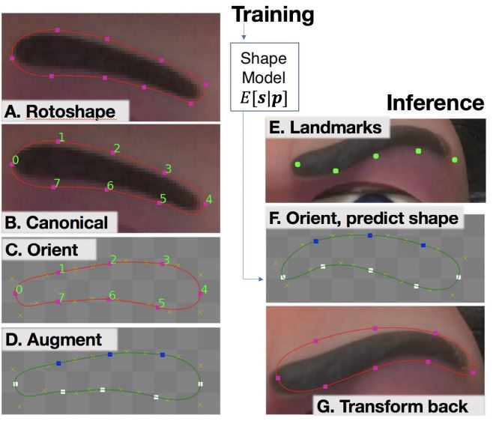
STUDY 6:
A LEARNING-BASED APPROACH TO PARAMETRIC
ROTOSCOPING OF MULTI-SHAPE SYSTEMS
STAGE 3: 2nd model uses the original roto ground truth To create roto
Shapes that can be used to paint out (via filler/dilate methods in nuke)

Slide 67
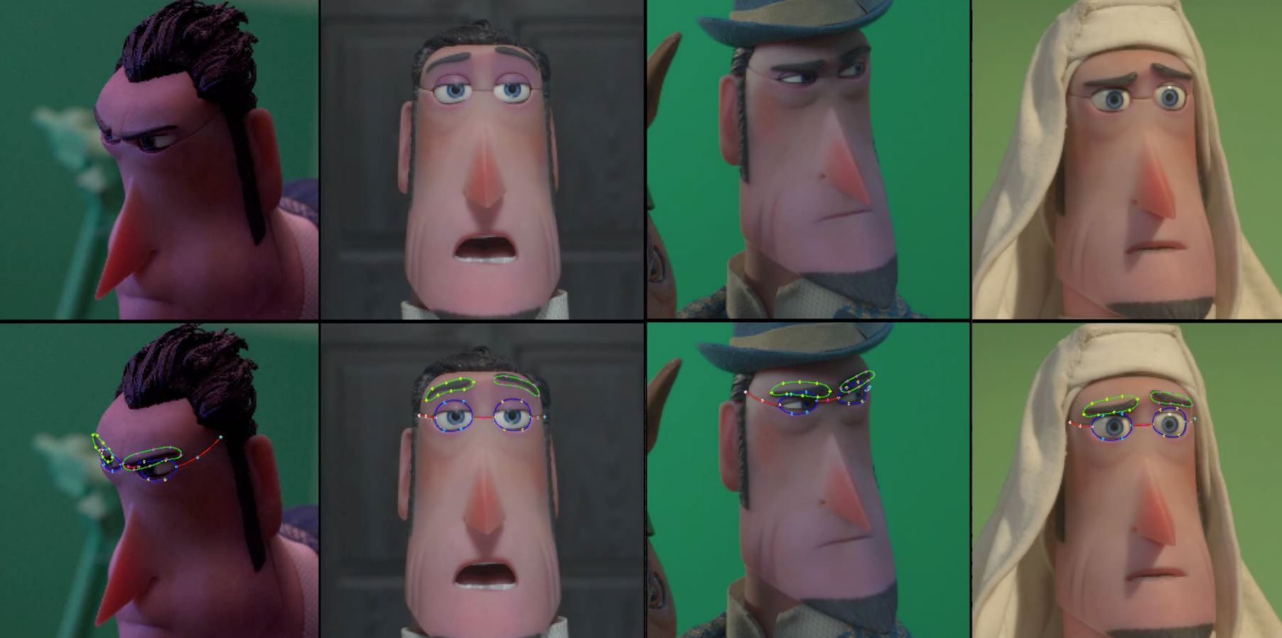
STUDY 5:
A LEARNING-BASED APPROACH TO PARAMETRIC
ROTOSCOPING OF MULTI-SHAPE SYSTEMS

Slide 68
STUDY 6:
A LEARNING-BASED APPROACH TO PARAMETRIC
ROTOSCOPING OF MULTI-SHAPE SYSTEMS
User can tweak/manipulate
Inferred points before the
2nd model is implemented to create
Roto splines
User can also tweak final
Roto splines when created

Slide 69
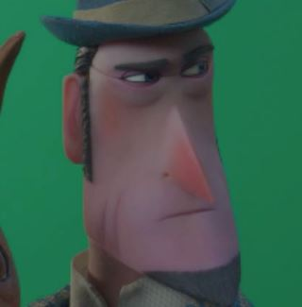
STUDY 6:
A LEARNING-BASED APPROACH TO PARAMETRIC
ROTOSCOPING OF MULTI-SHAPE SYSTEMS
CHALLENGING SHOTS WITH LOW ACCURACY
CHARACTER OCCLUDED BY A HAT
FRAMED FROM SIDE PROFILE

Slide 70
STUDY 6:
A LEARNING-BASED APPROACH TO PARAMETRIC
ROTOSCOPING OF MULTI-SHAPE SYSTEMS
FUTURE APPLICATIONS FOR THIS PROCESS….
FACIAL DE-AGING ON REAL ACTORS
REMOVING OR ADDING SCARS
ADDING STAINS AND INJURIES TO FACE

Slide 71
CONCLUSION:
DEEP LEARNING IN COMPOSITING IS LIKE A SEEING EYE DOG
IT CAN LEAD YOU WHERE YOU WANT TO GO BUT CAN GET LOST ALONG THE WAY BUT IF You NUDGE THE DOG hard towards a whole New direction YOU MIGHT END UP IN THE WOODS.
YOU HAVE TO TEACH THE DOG, FEED and re-feed THE DOG, but EVENTUALLY USE the human mind FOR HELP ALONG THE WAY

Slide 72
CONCLUSION:
REALITY TODAY:
THE WORK OF A SKILLED ARTIST CANNOT BE REPLACED BY MACHINE LEARNING ALGORITHMS.
SIMPLE BINARY TASKS ARE BEST SUITED FOR INITIAL WORKFLOW BUT MUST BE FOLLOWED UP BY THE FINAL REVIEW
ROTOSCOPING, ALTHOUGH BINARY IN NATURE, STILL REQUIRES
HUMAN SUPERVISION/TWEAKING

